Slide 1

April 16, 2024
TOP TIPS TO ACE YOUR NEXT FIRE DEPARTMENT PROMOTIONAL EXAM!
Steve Prziborowski
Deputy Chief (Ret.)

Slide 2
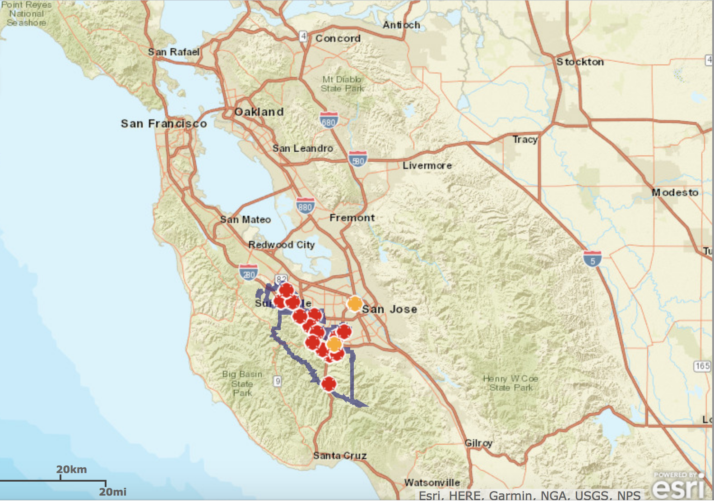
WHO I AM / AM NOT:
  Beginning Thoughts
  7

Slide 3
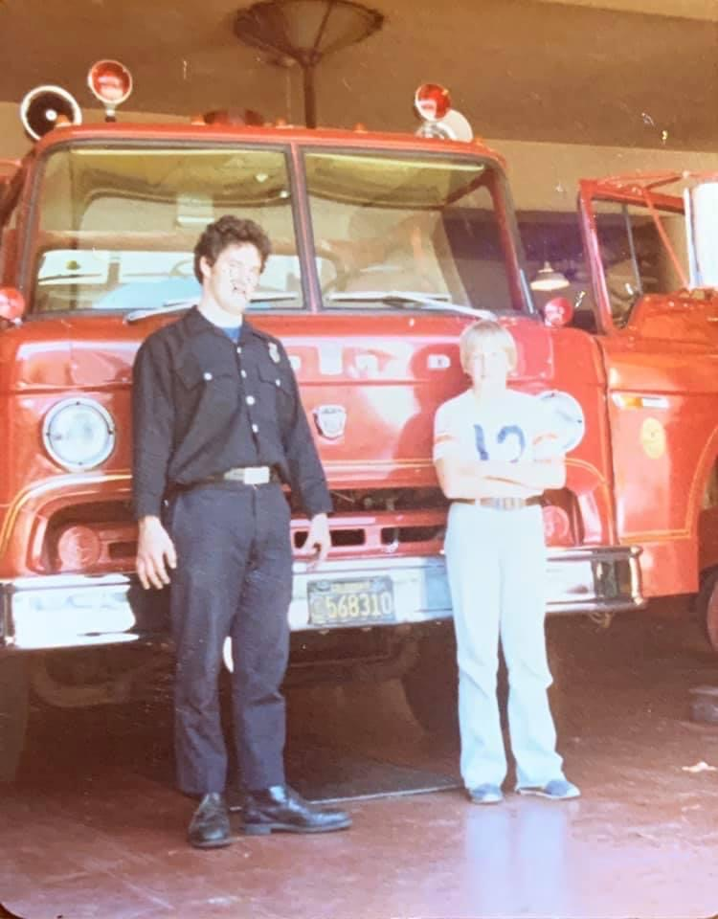
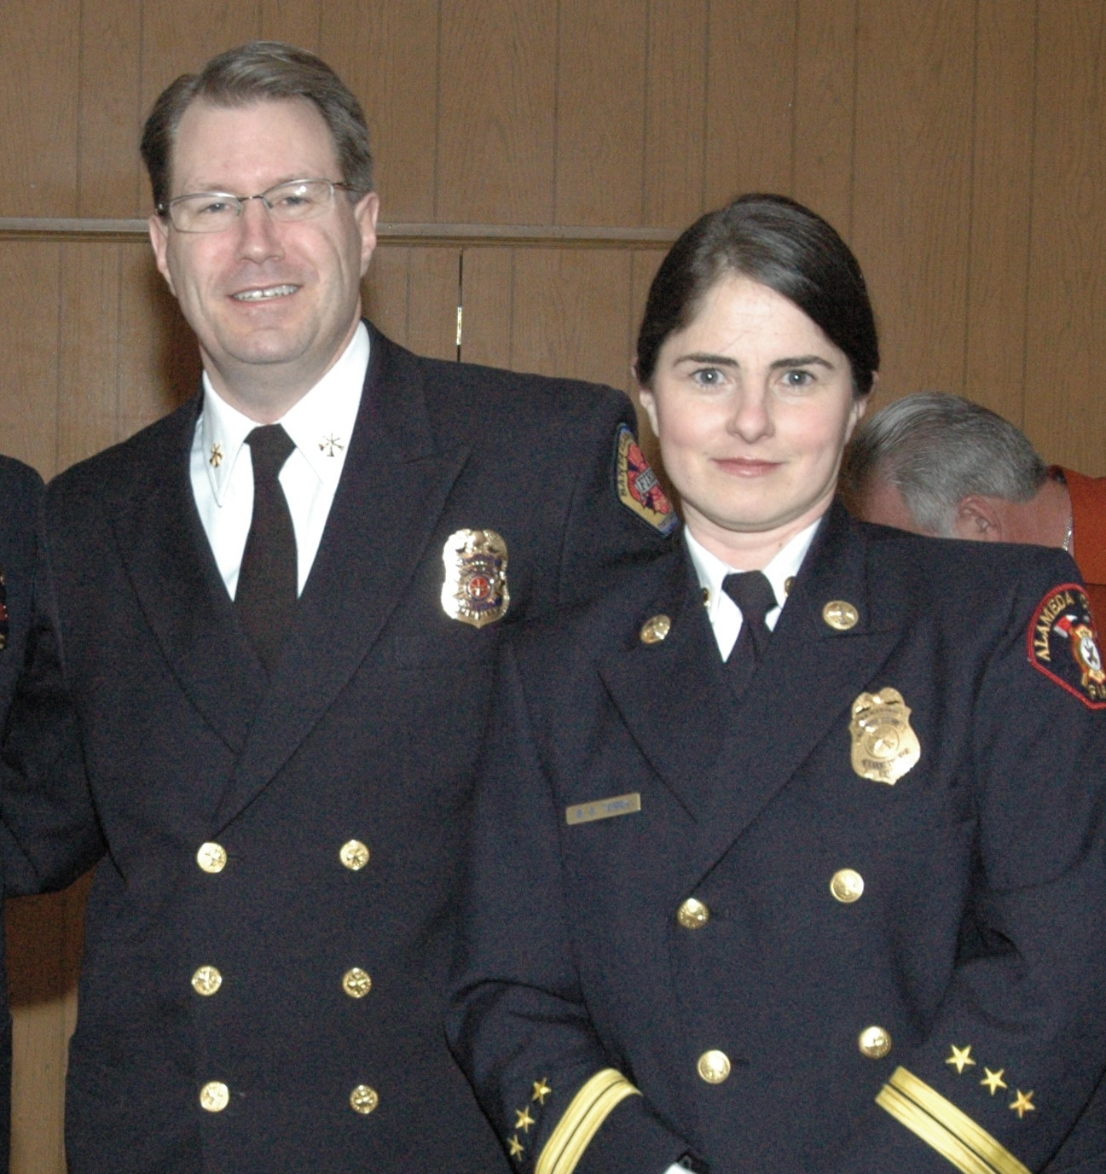
Steve Prziborowski
  32+ years fire service & teaching experience………
  Fire Explorer: Alameda (CA) F.D.
  Student FF: Oakland (CA) F.D.
  Paid Call FF: Elk Grove (CA) F.D.
  Santa Clara County (CA) Fire Department:
  Firefighter/Engineer – Captain – Battalion Chief – Deputy Chief (Training, Ops, Admin)
  Instructor: Chabot College Fire Program,
  NFA, Leadership/Officer Development
  Contributing Editor: Firehouse Magazine
  2020: Ronny J. Coleman Leadership Legacy Award - CPSE
  2008: California Fire Instructor of the Year
  Married: Bonnie – 24 years +

Slide 4

FREE RESOURCES:
  Promotional Prep/Officer Development:
  www.code3firetraining.com
    (click the FREE STUFF link)
  Entry-Level Firefighter Preparation:
  www.chabotfire.com
    (click the FREE STUFF link)

Slide 5


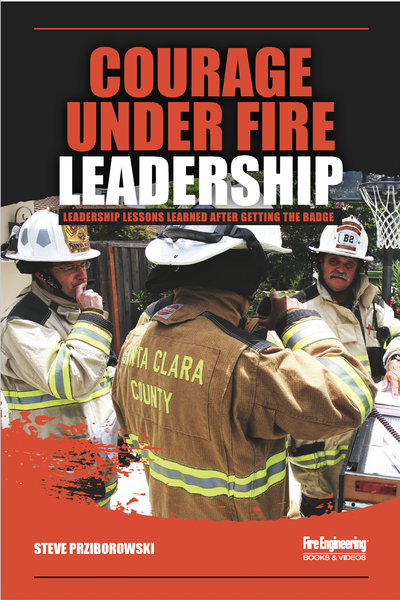


ENTRY-LEVEL & PROMOTIONAL RESOURCES:
    iTunes – Amazon
    www.code3firetraining.com

Slide 6
OBJECTIVES:
Identify 13 tips to help you prepare for your promotional exam
Provide an overview of the fire service assessment center process & typical events encountered
Provide tools to create an action plan to best prepare for the position & the actual testing process

Slide 7
OBJECTIVES:
Provide common mistakes candidates make when participating in promotional examinations and the specific events
Provide typical traits of successful performers in promotional examinations

Slide 8
THIS CLASS IS NOT:
A department specific promotional class that will give you all the answers and/or nuggets to be successful...
Going to cover everything you need to know or do during your next exam
Going to have enough time to cover or practice everything we need to – we have 4 hours together.

Slide 9
TOP 13 TIPS TO HELP YOU FOCUS & ACE YOUR NEXT PROMOTIONAL EXAM

Slide 10
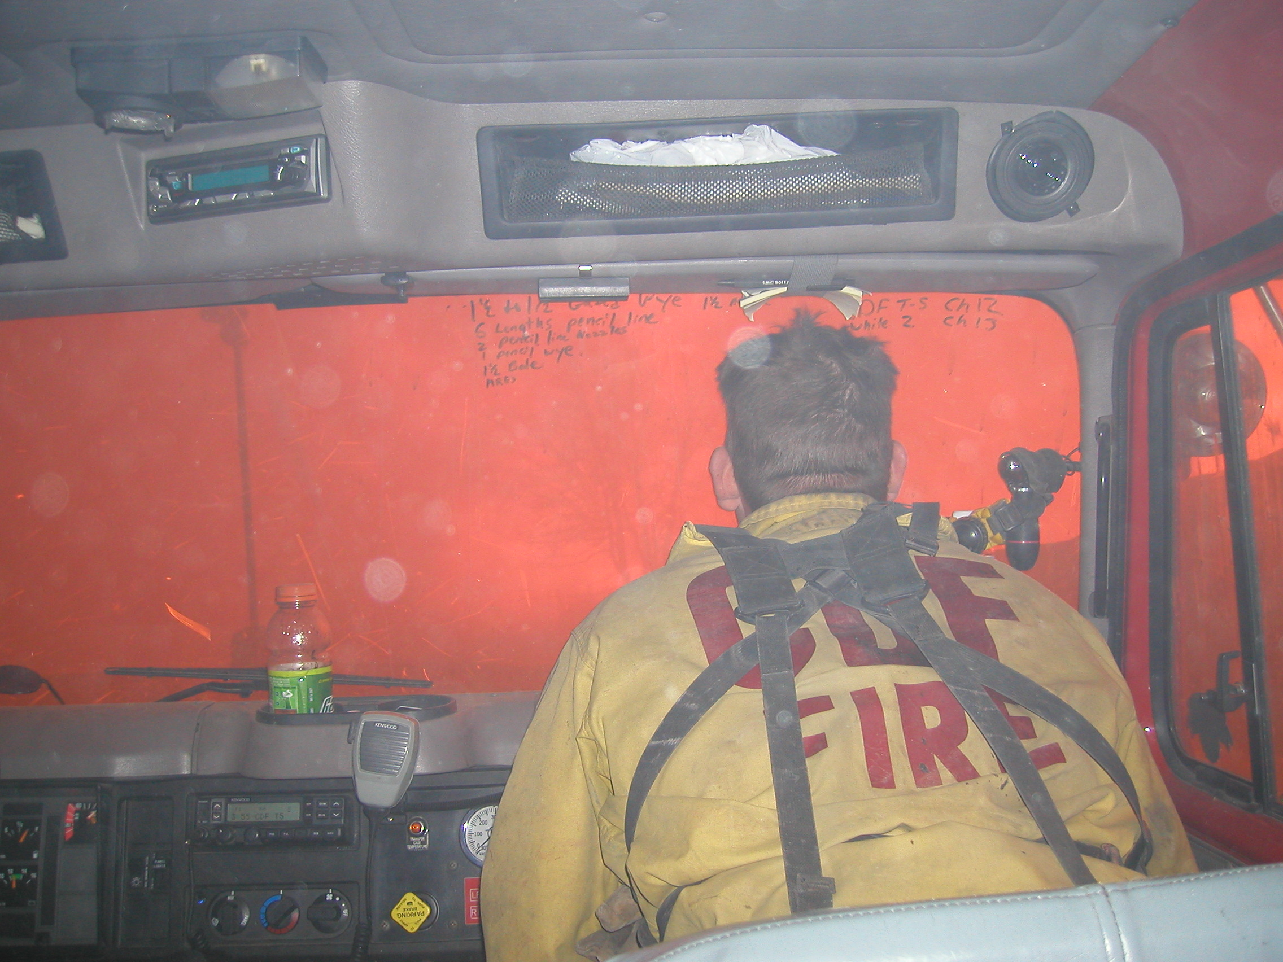
TIP #1:
Prepare for the POSITION & NOT Just for the Test

Slide 11
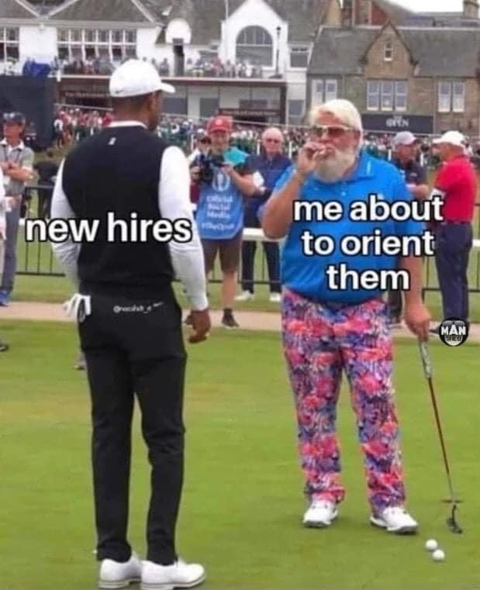
DID YOU KNOW:
You’re not just a supervisor, you’re a
  HR Professional
  Risk Manager
  Health & Safety Officer
  Training Officer
  Designated Adult
  Supervisor, manager, role model, mentor, follower & leader!

Slide 12
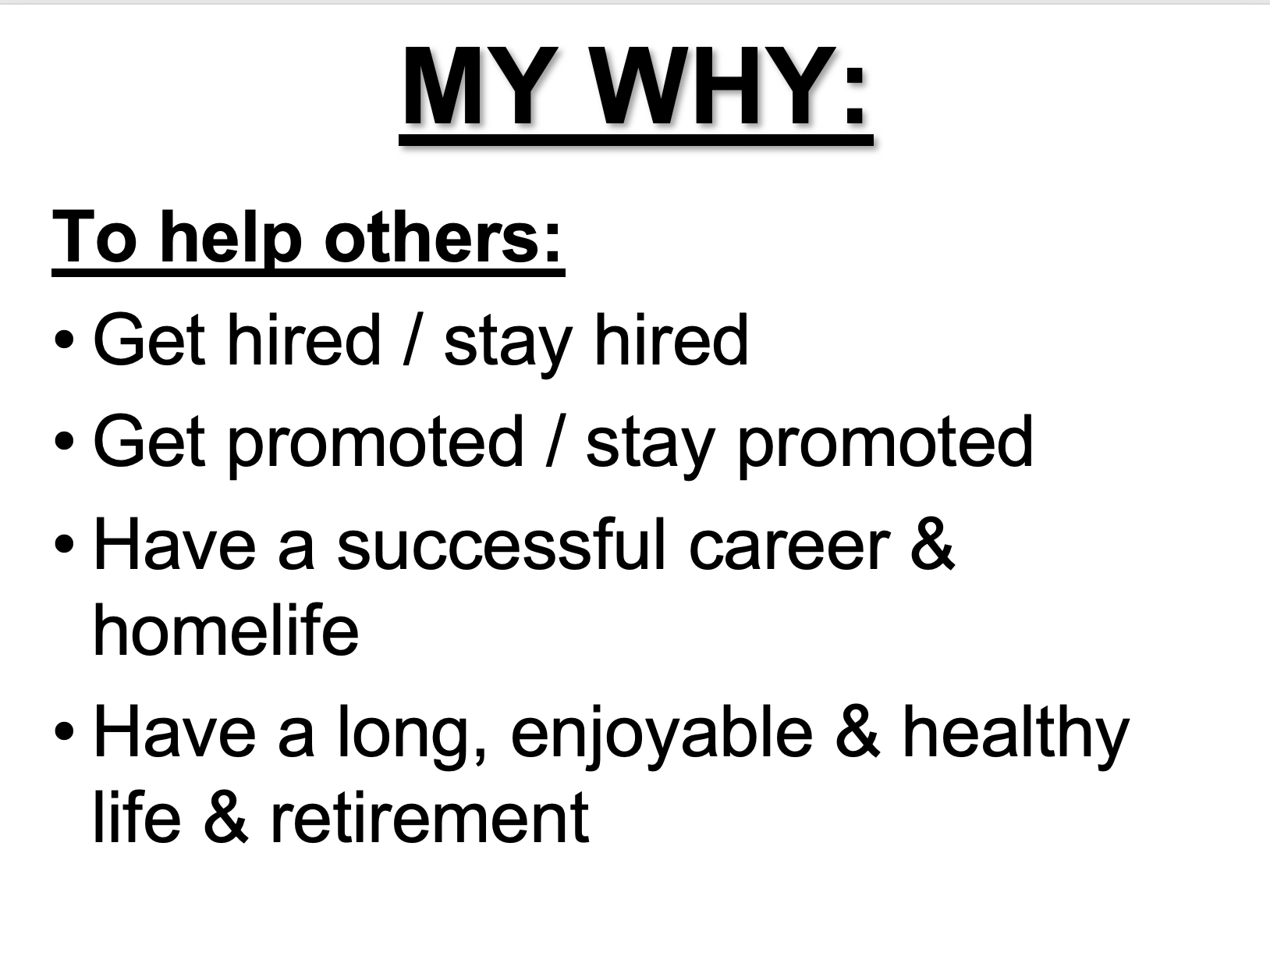
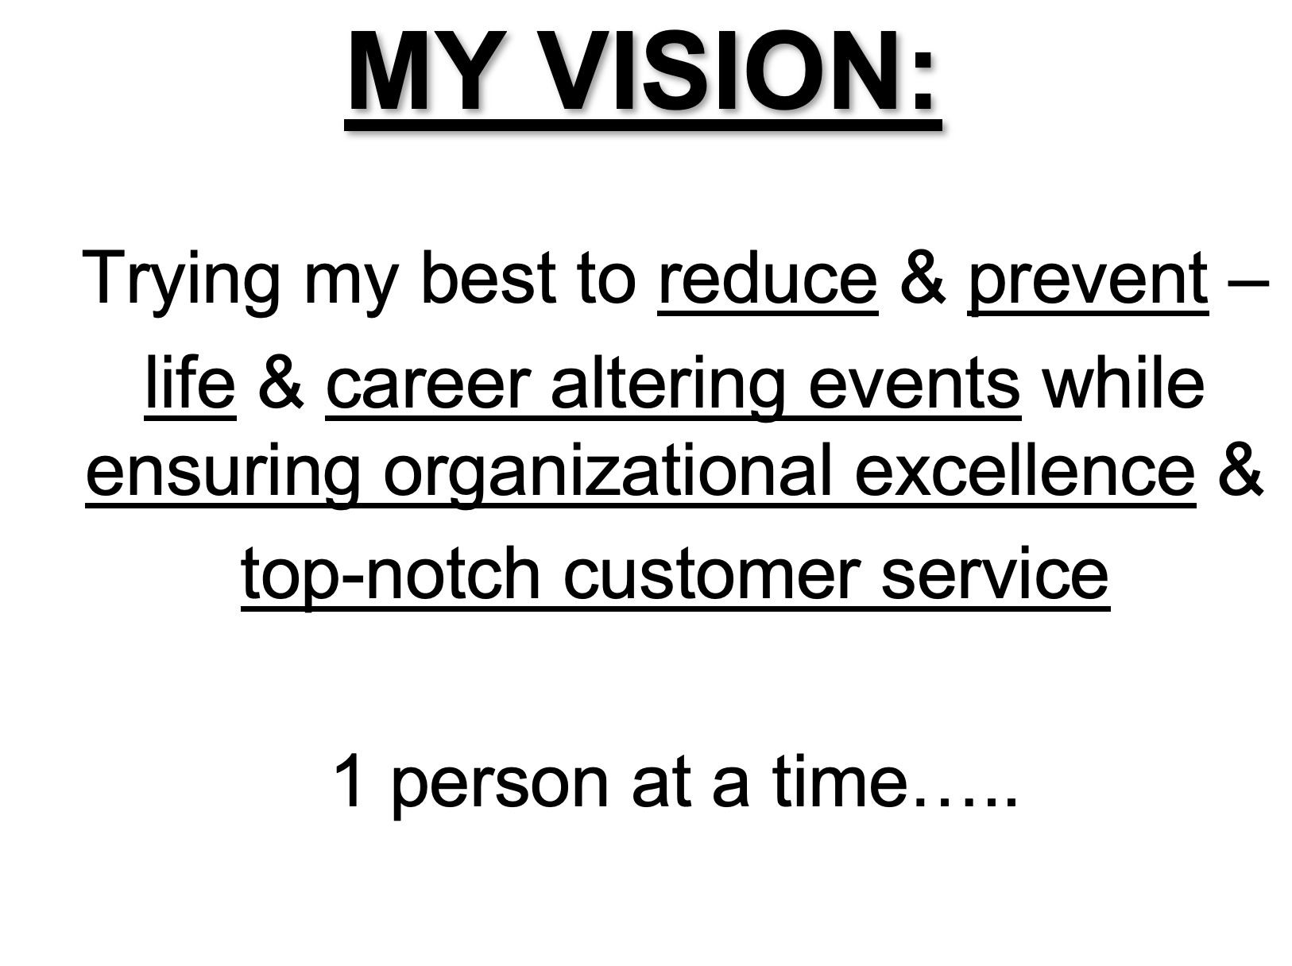
TIP #2:
Know your WHY &
Have a Vision

Slide 13
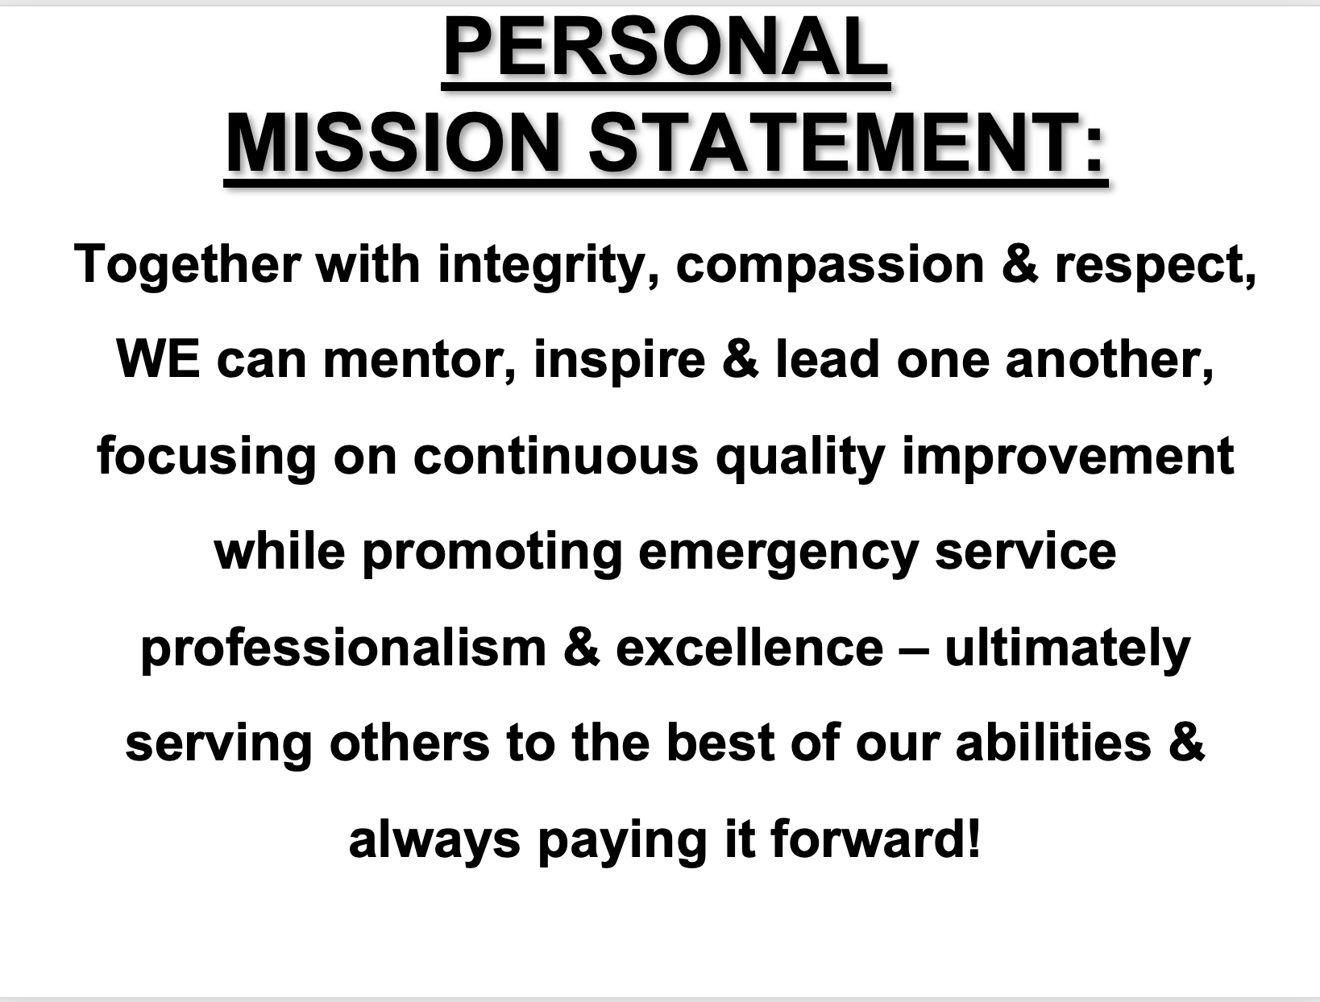
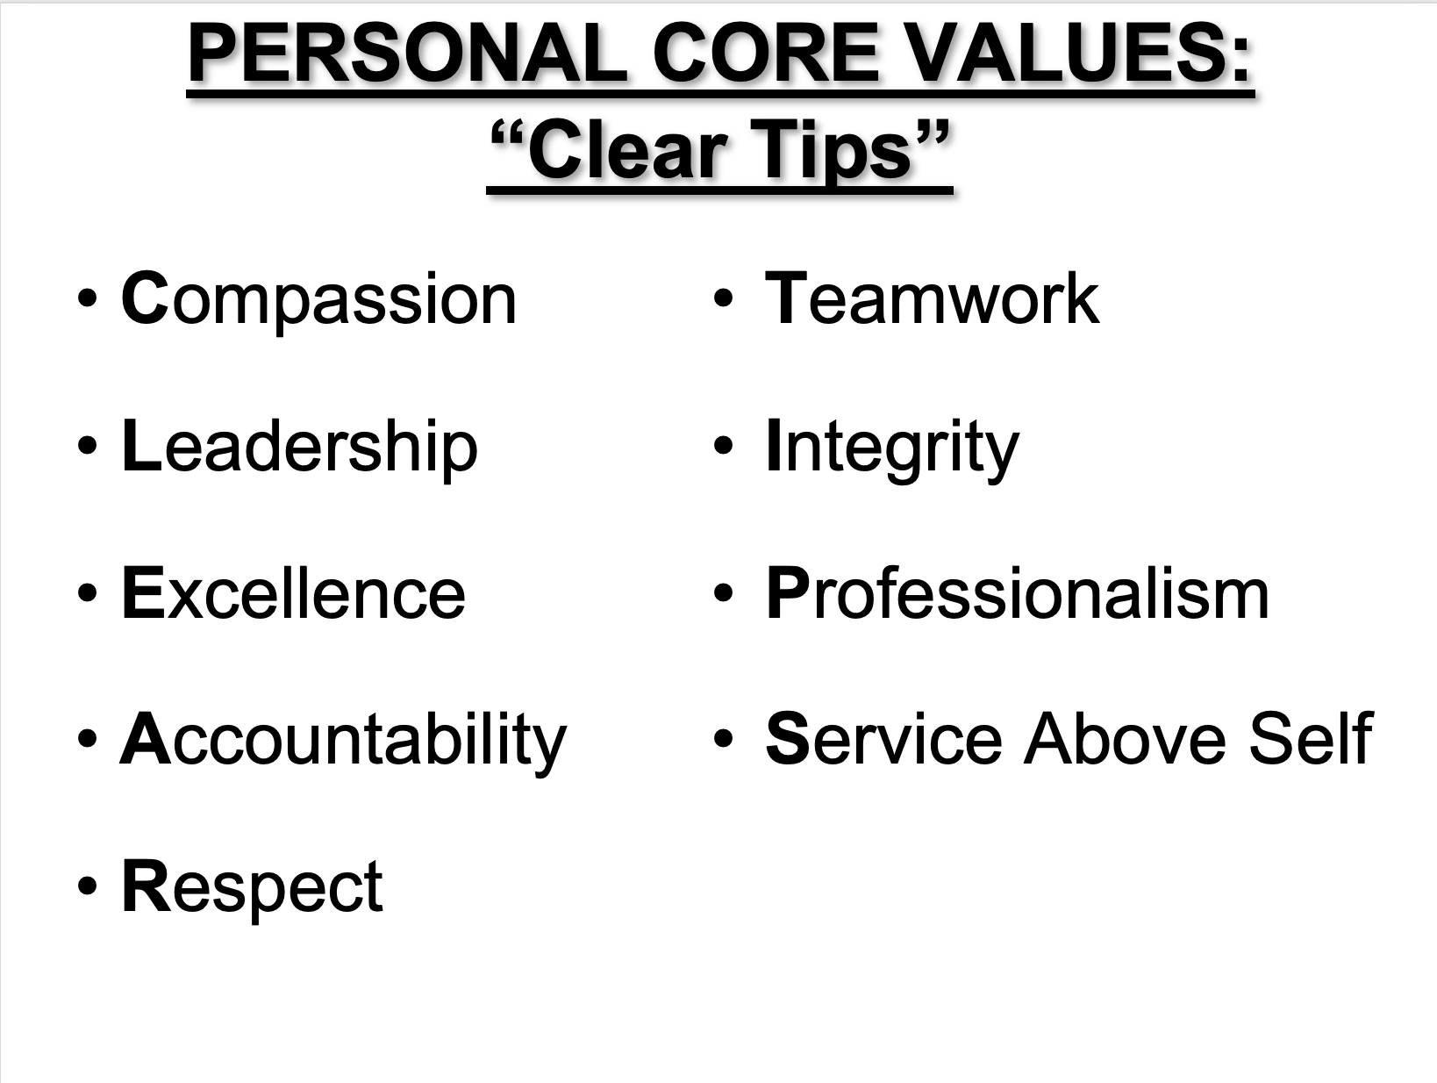
TIP #3:
Create your Mission Statement & Values Statement

Slide 14
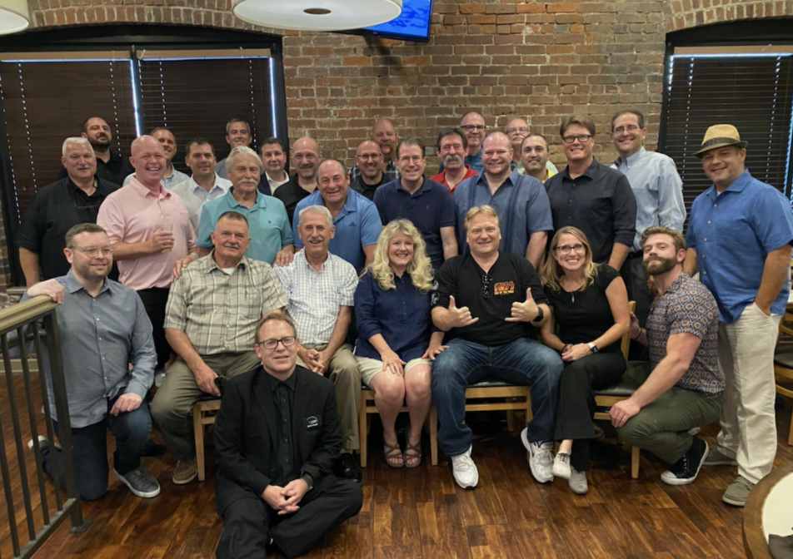
TIP #4:
Start Building & Maintaining Positive Working Relationships

Slide 15
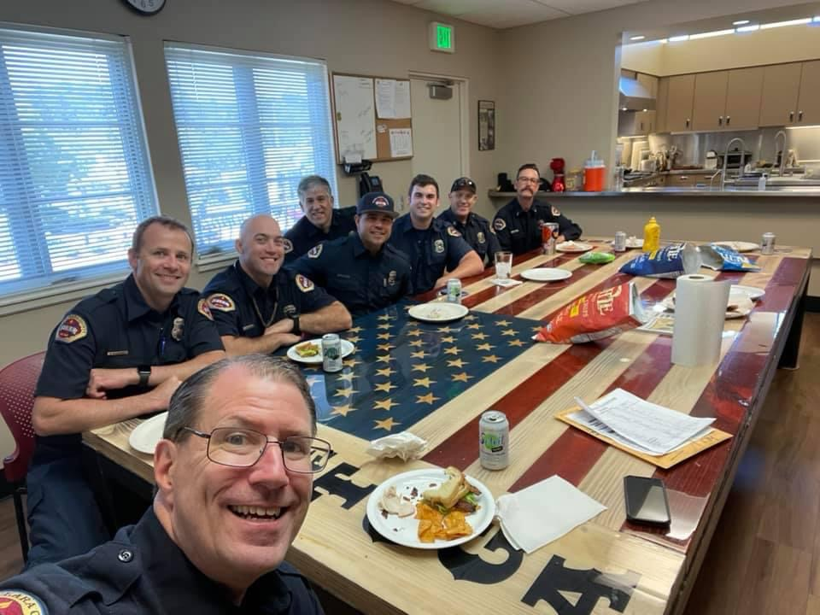
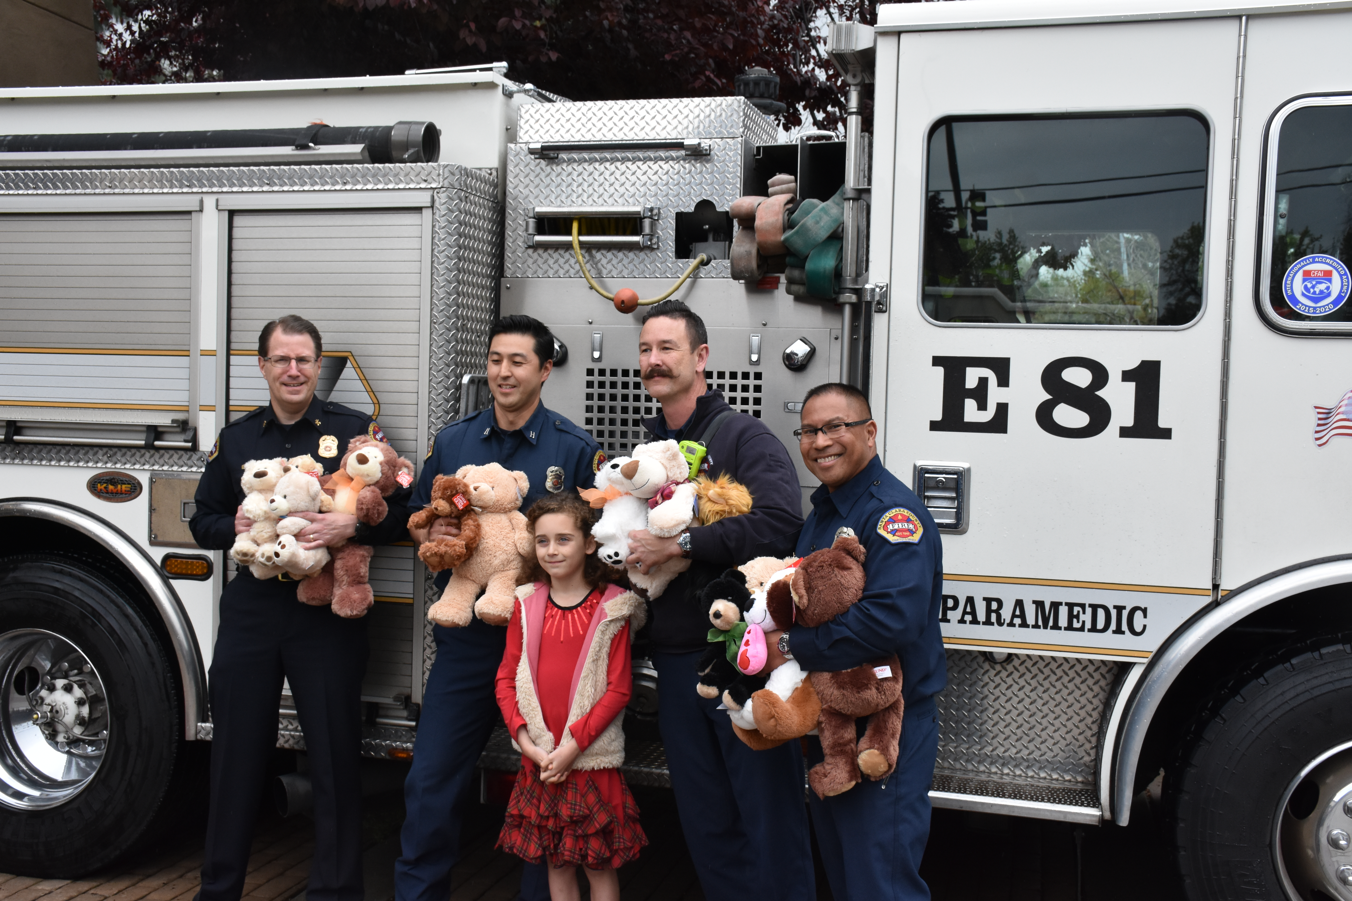
TIP #5:
Don’t Forget Why WE Are Here & Why YOU Are Here (In your Promoted Position)

Slide 16
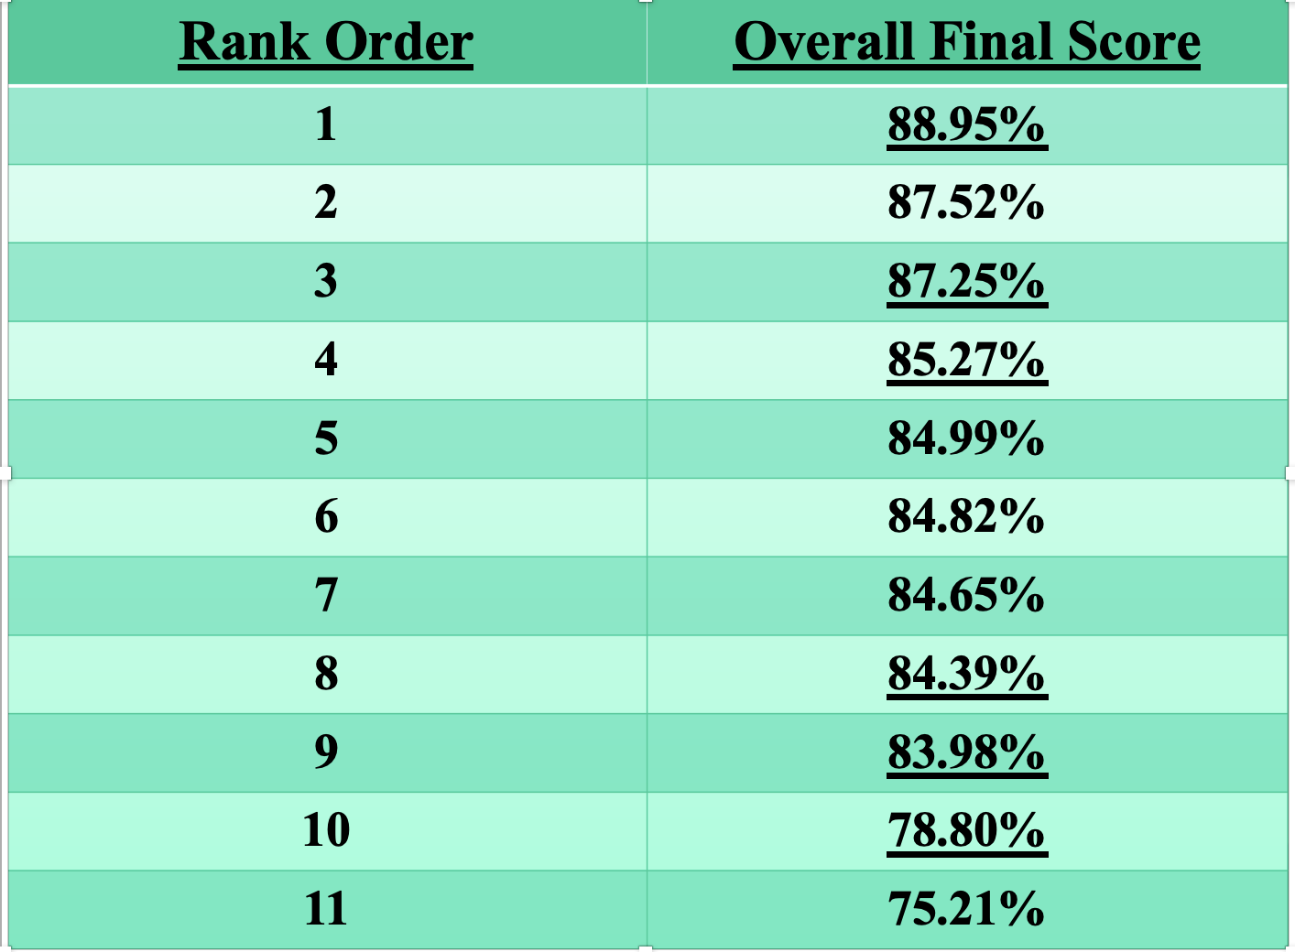
TIP #6:
Remember EVERY Point Counts

Slide 17
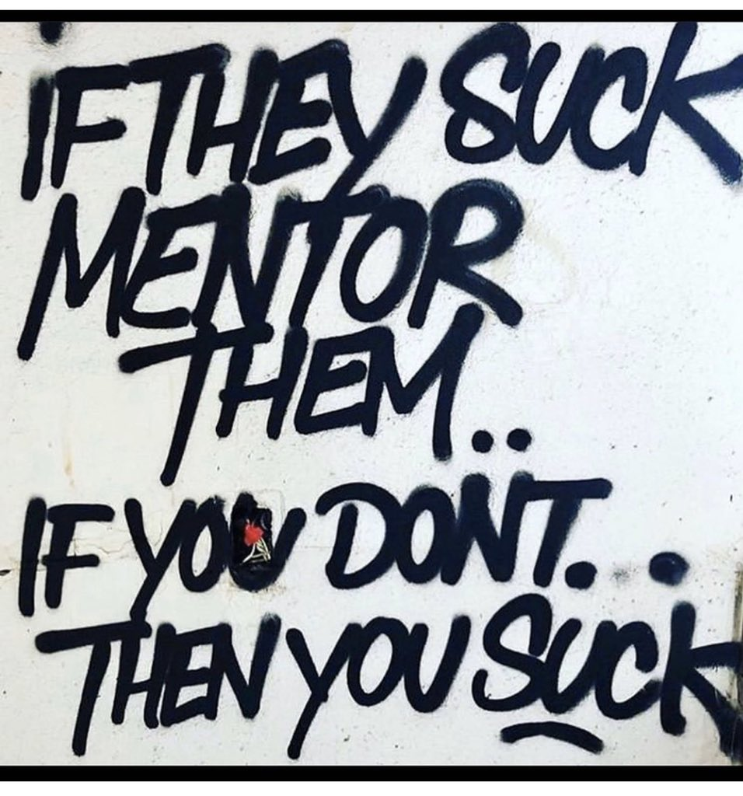
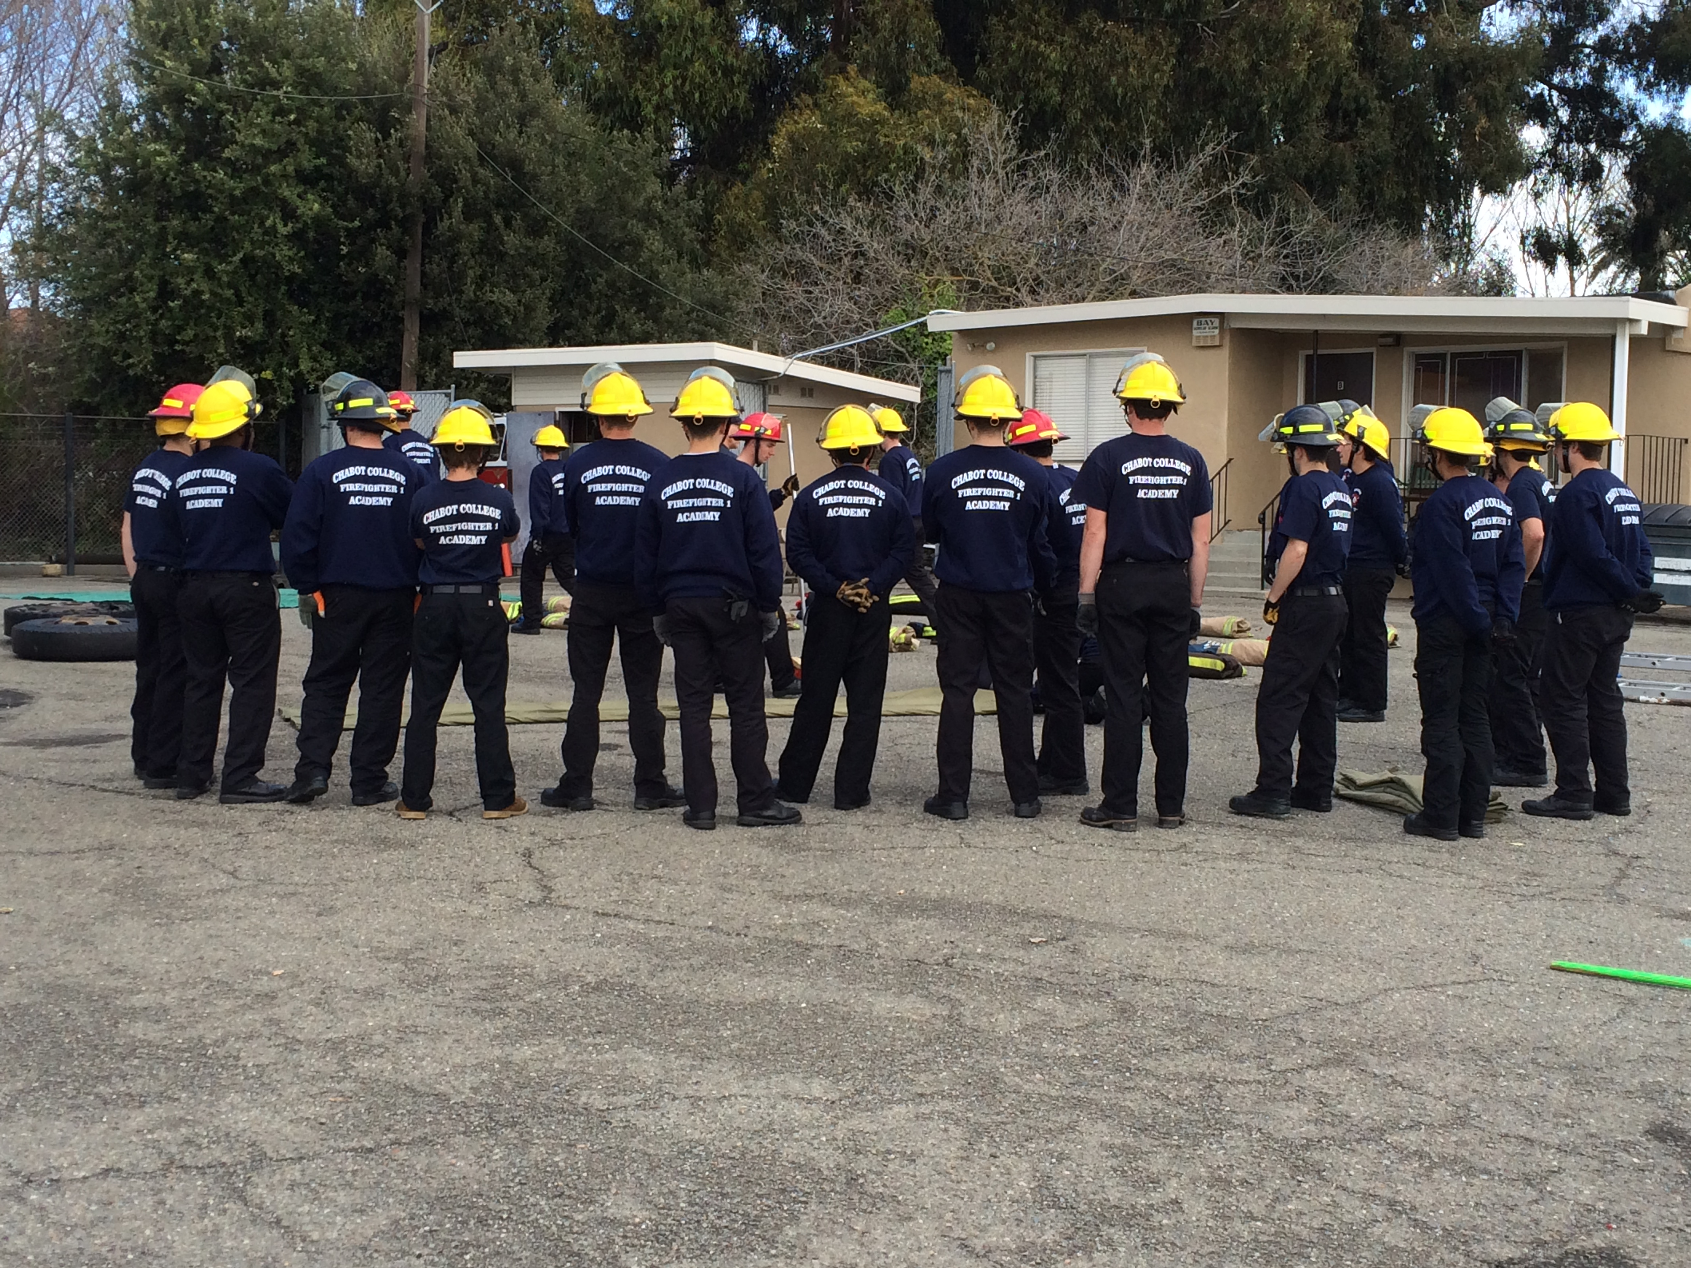
TIP #7:
Be a Mentor for Someone Else

Slide 18
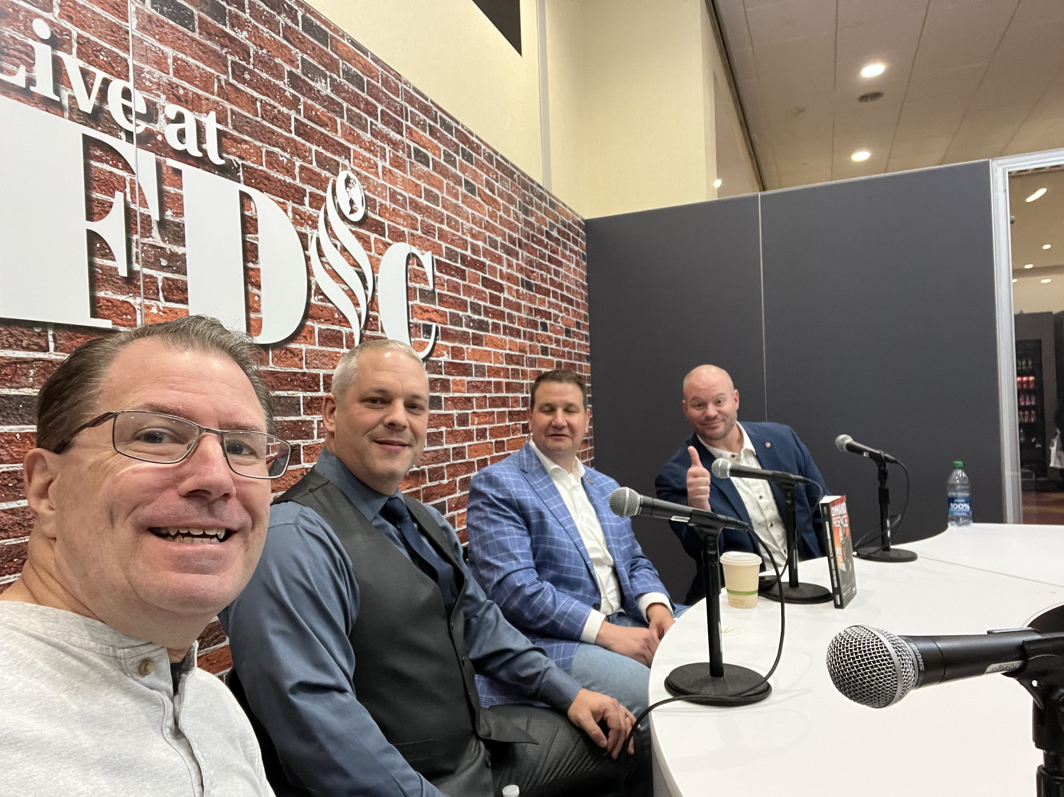
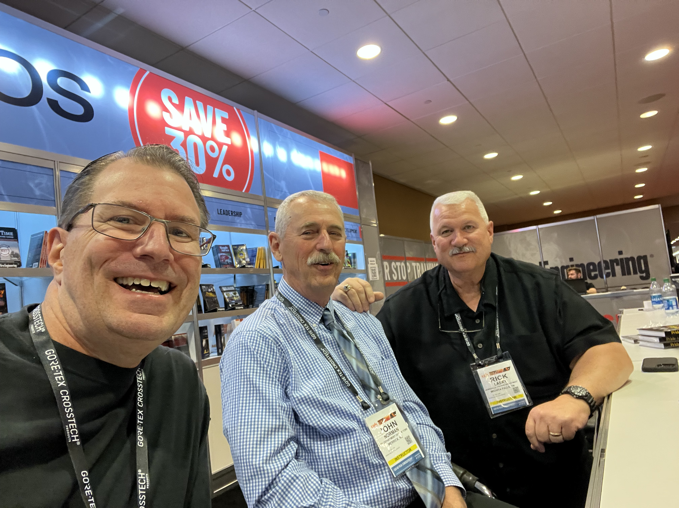
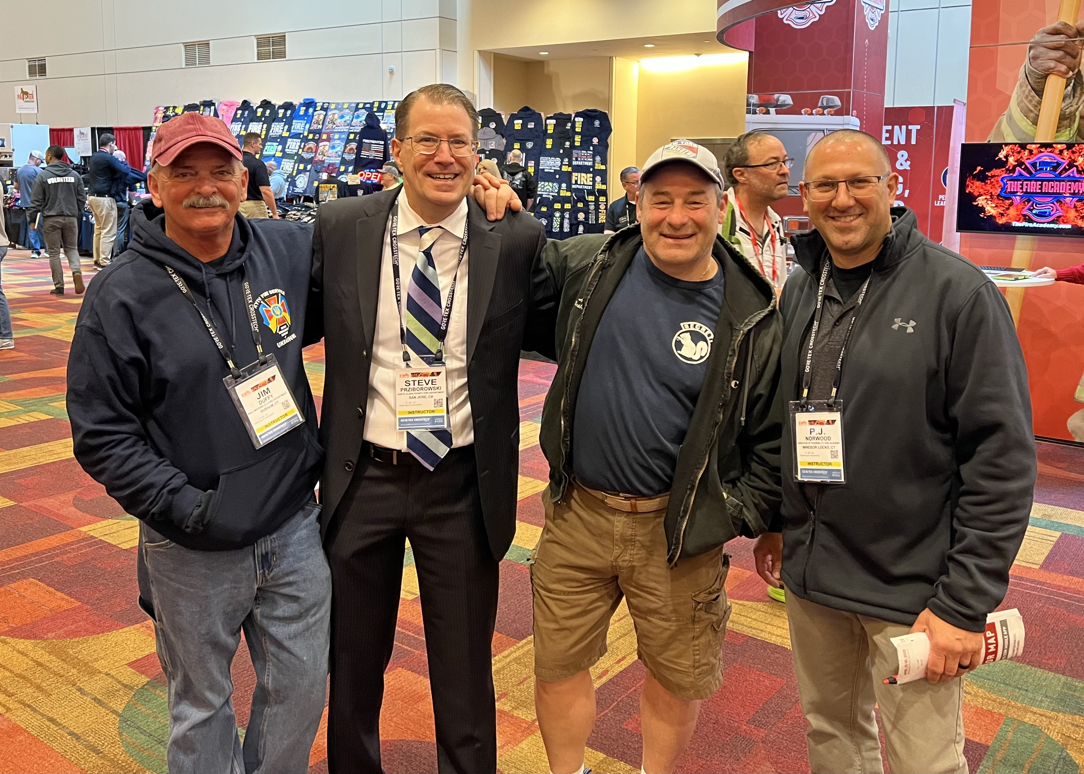
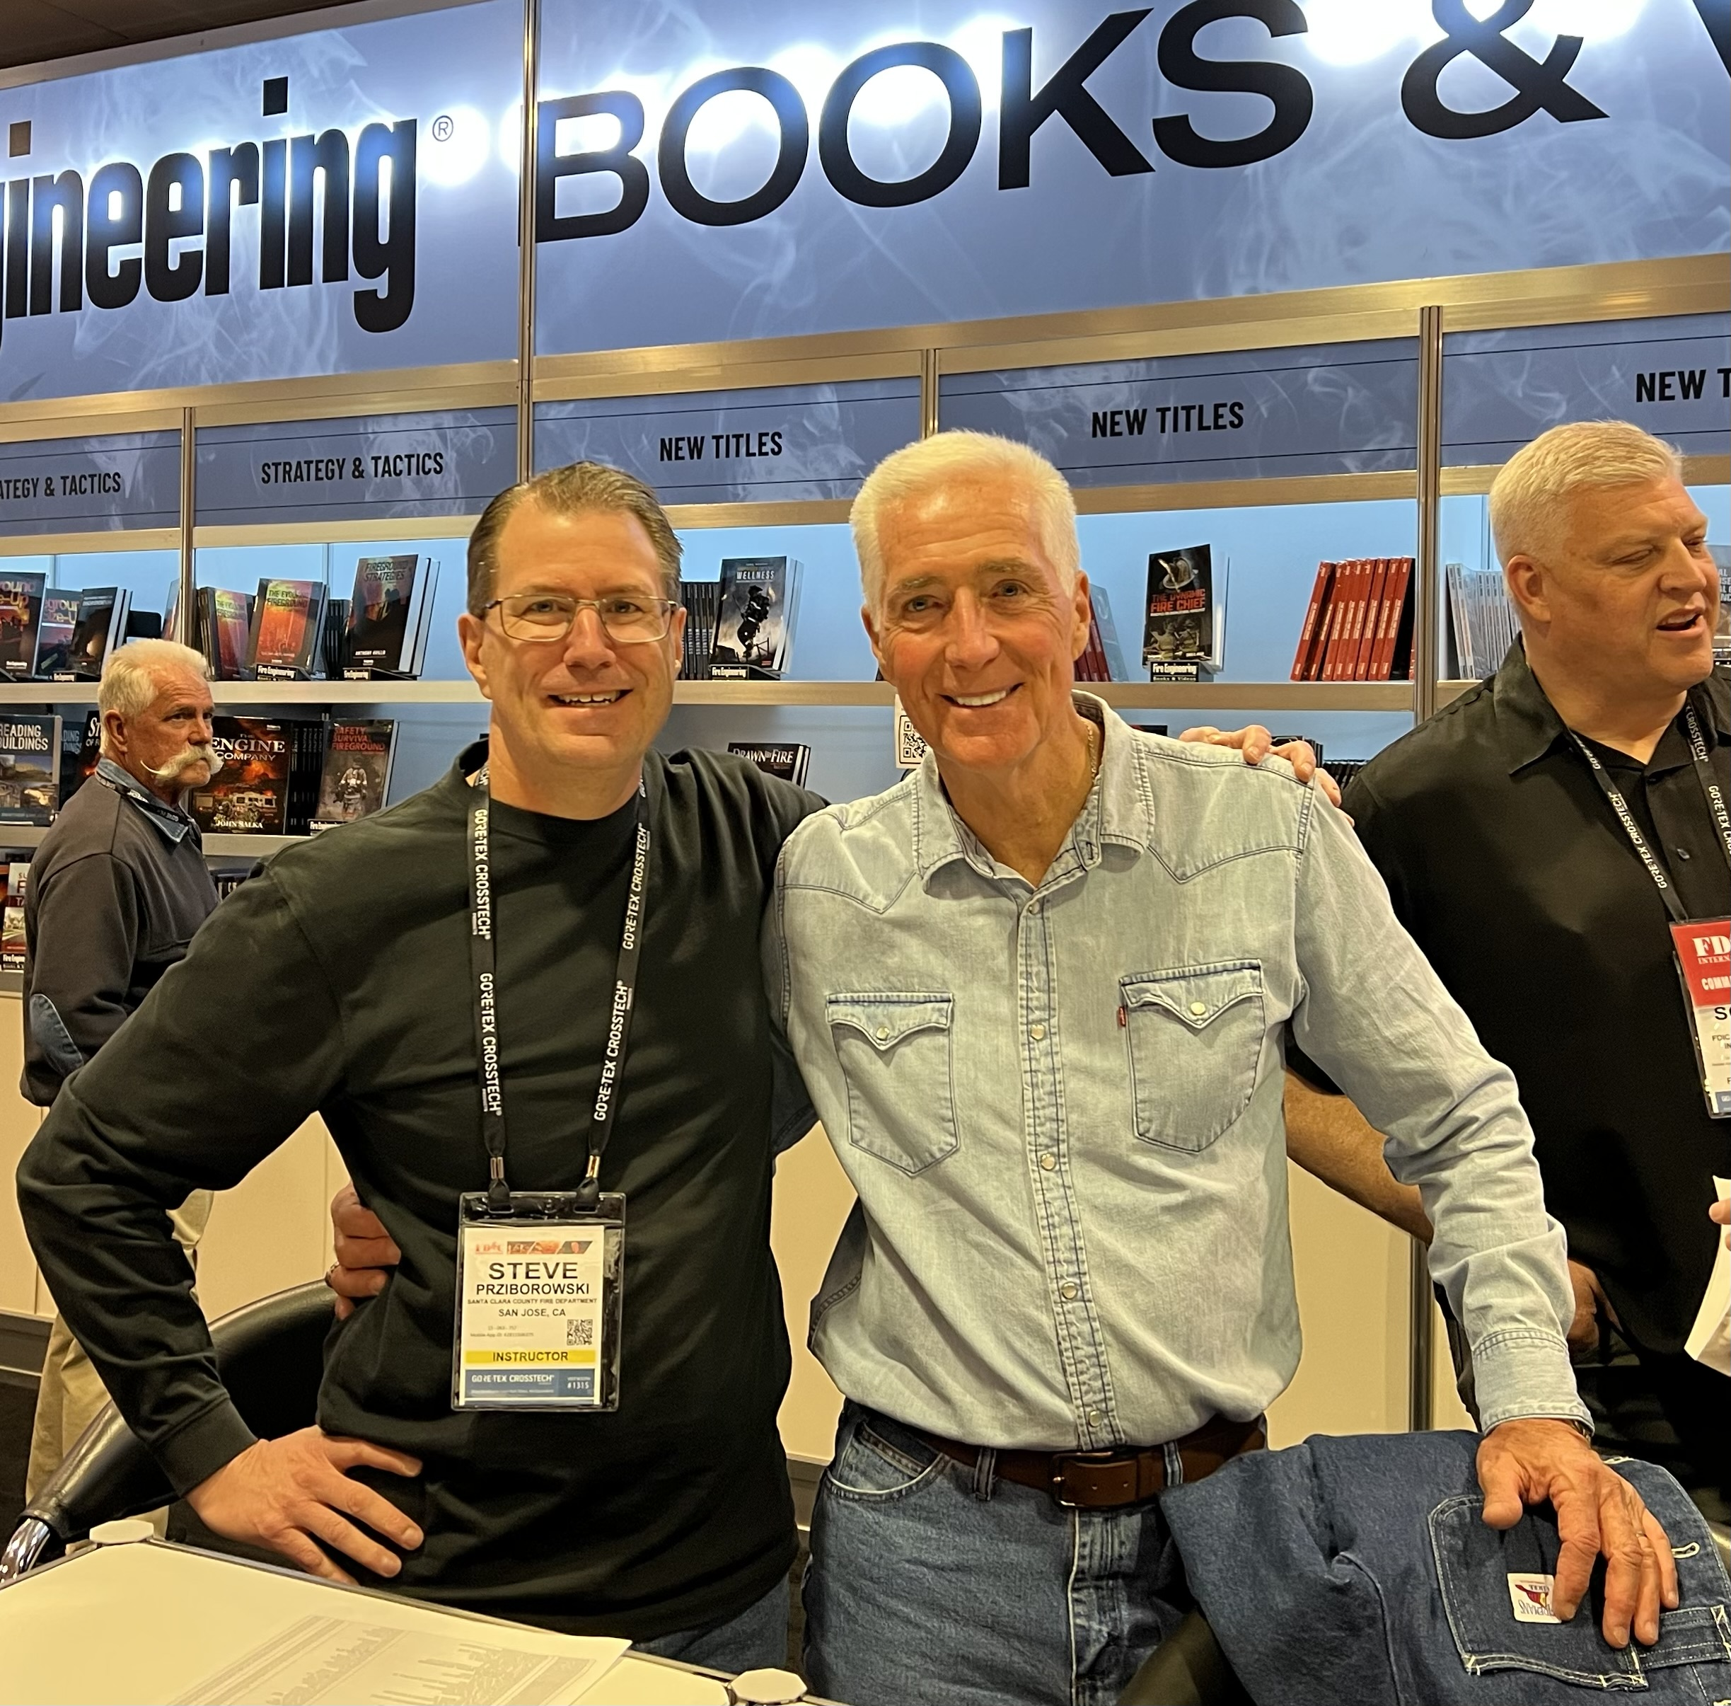
TIP #8:
Find your Mentors

Slide 19
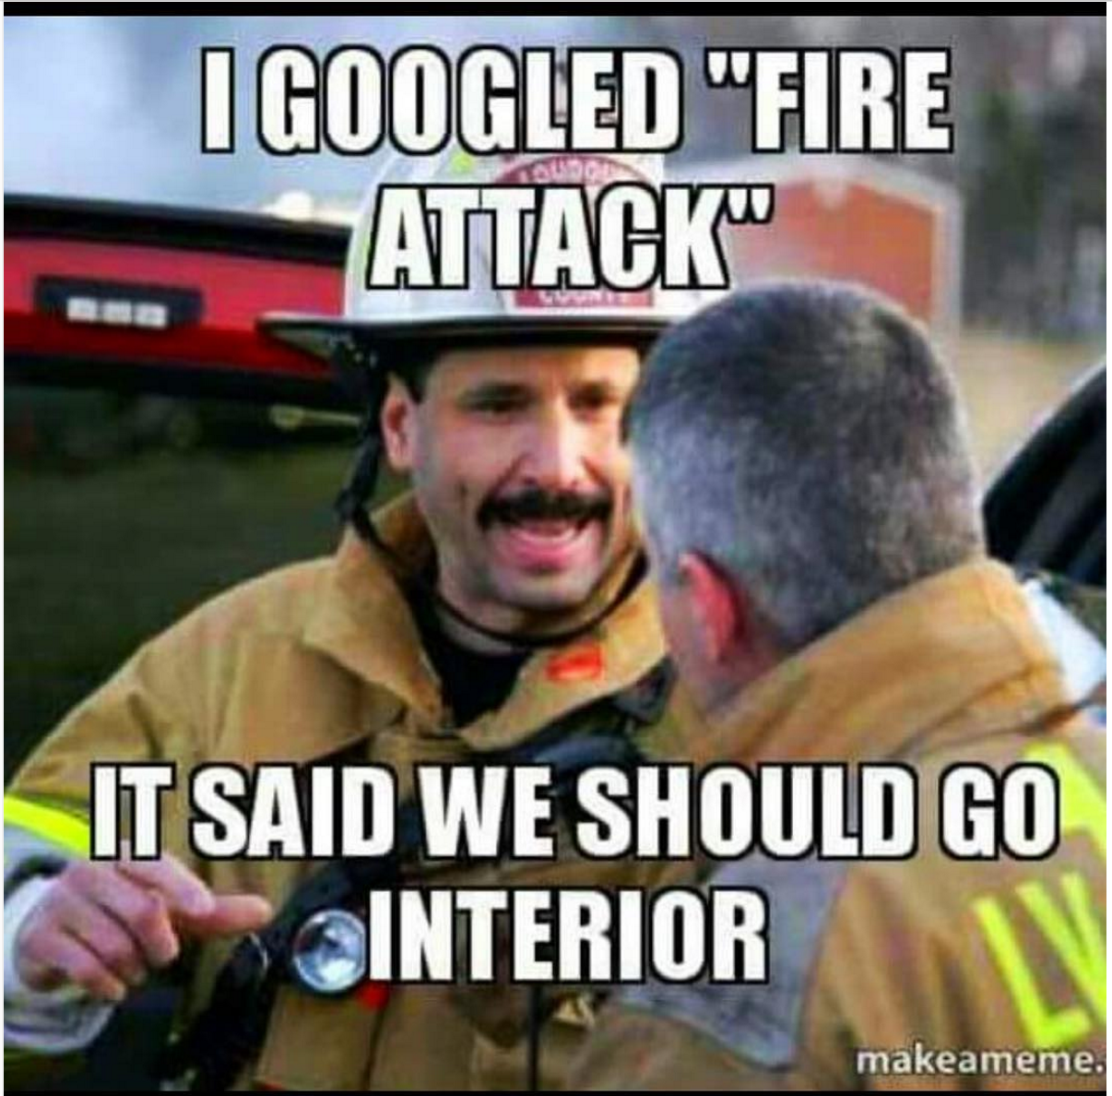
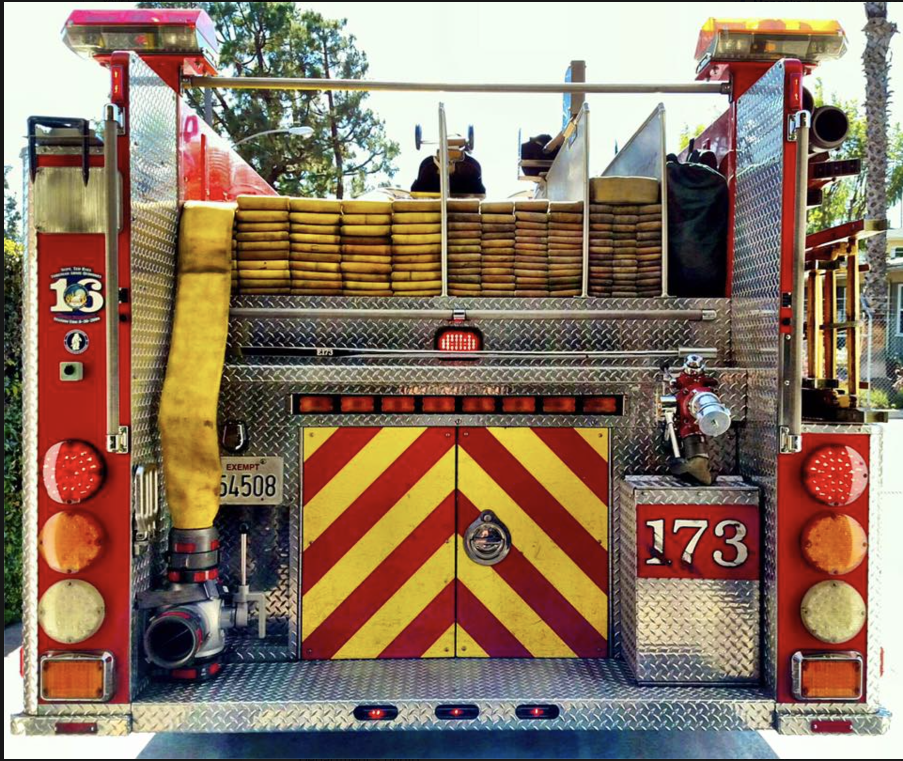
TIP #9:
Know What “They” Are Looking For

Slide 20
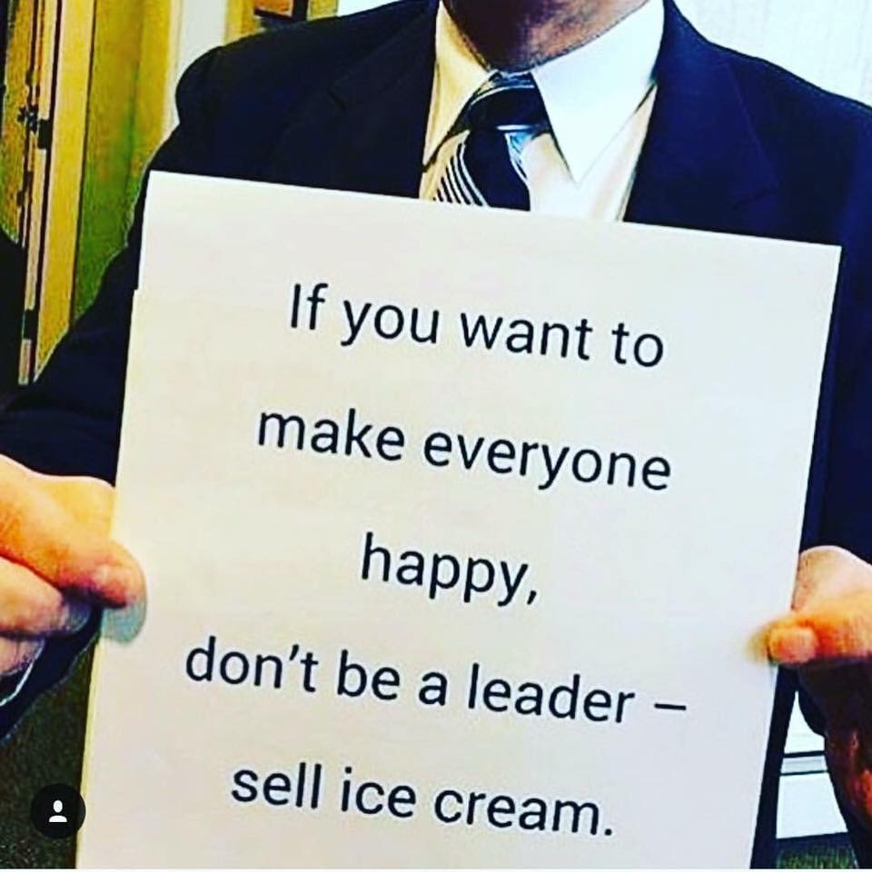
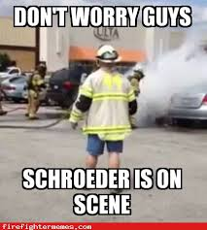
TIP #10:
Continuously Strive for Credibility & Respect, As Opposed to Just Being Liked

Slide 21
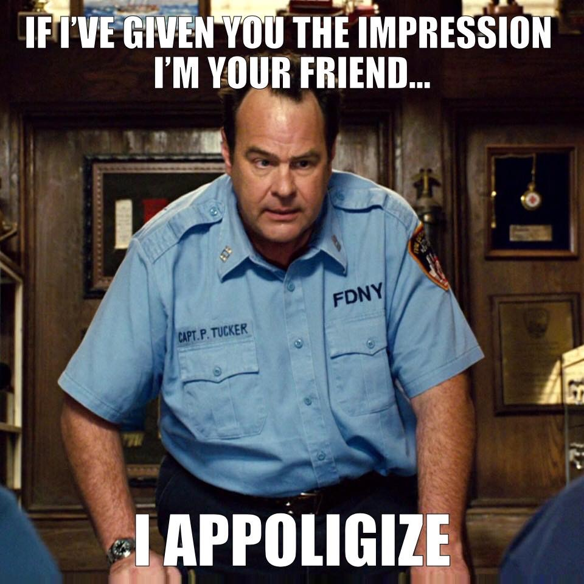
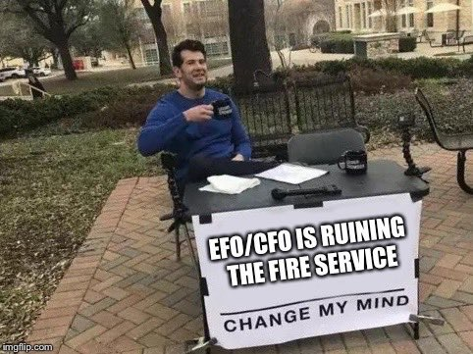
TIP #11:
Remember We Promote People and NOT Resumes

Slide 22
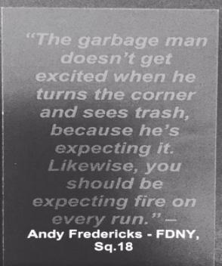
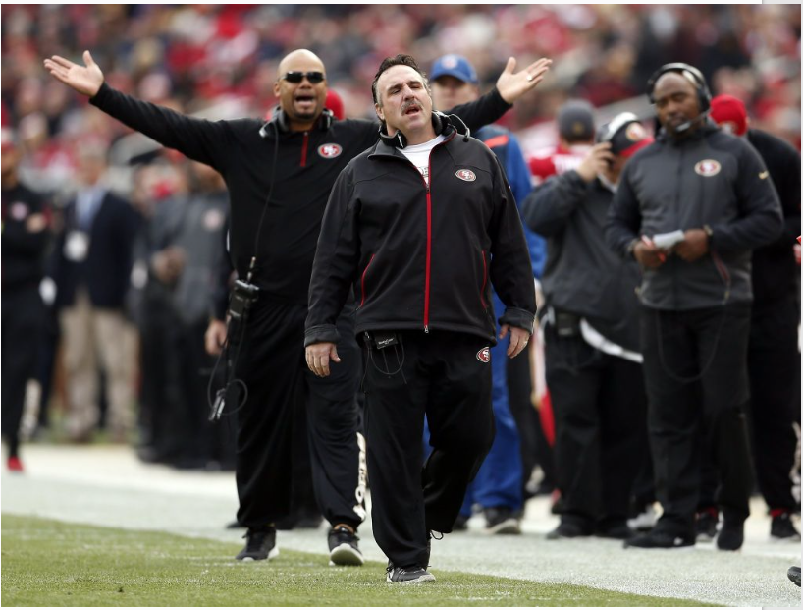
TIP #12:
Go Into the Process Positive – But NOT So Positive you Set Yourself Up for Failure!

Slide 23
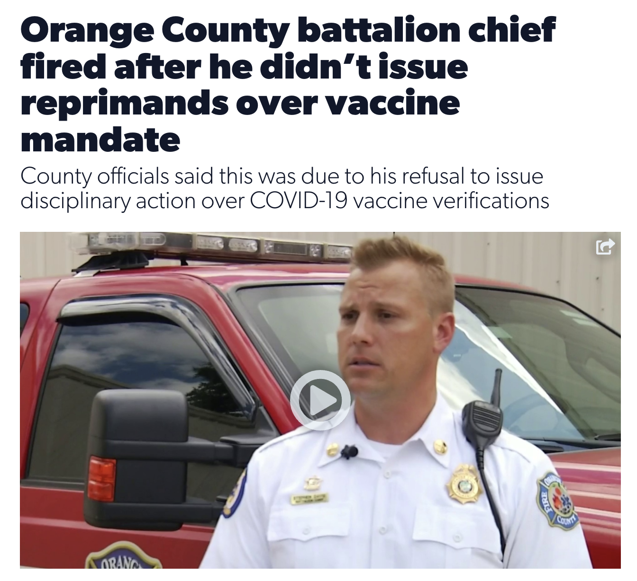
TIP #13:
Understand the position you are in or aspiring to be in & if you don’t want to do the job – do not take the position!

Slide 24
TOP 10 PITFALLS OF POOR PERFORMERS ON PROMOTIONAL EXAMS

Slide 25
TOP 10 PITFALLS OF POOR PERFORMERS:
Lack of preparing / Not preparing for the position
Focusing too much on “checking-the-box”
Inability to think “long-term” or “big picture”

Slide 26
TOP 10 PITFALLS OF POOR PERFORMERS:
Lack of knowledge of SOP/SOGs, policies, standard/accepted practices, etc.
Not understanding the scoring dimensions
Nervousness gets the best of them

Slide 27
TOP 10 PITFALLS OF POOR PERFORMERS:
Lack of detail / unable to justify or defend actions or non-actions
Unsafe / unorthodox practices

Slide 28
TOP 10 PITFALLS OF POOR PERFORMERS:
Inability to be the DESIGNATED ADULT!
Inability to demonstrate to the raters they can hit the ground running – not just be a safe beginner!

Slide 29
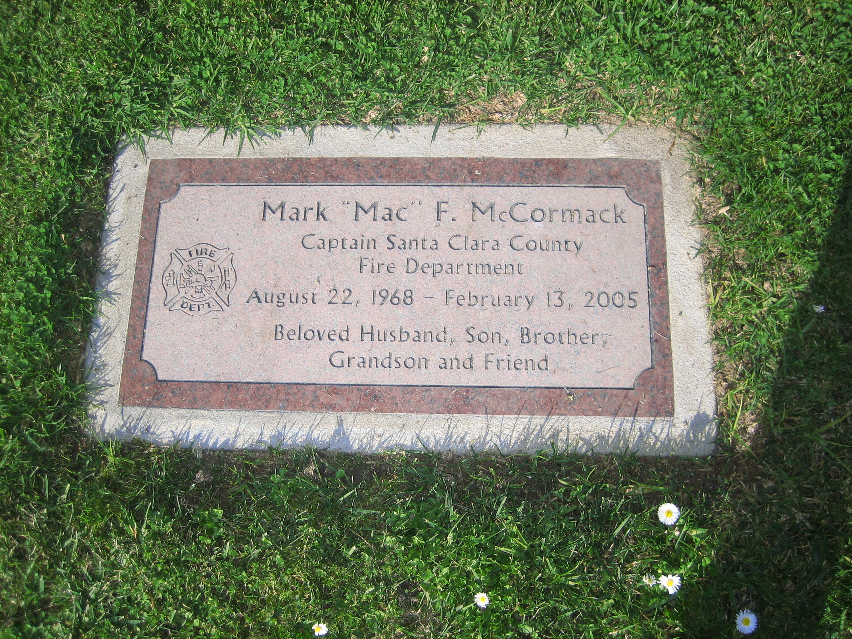
WHY PREPARE FOR THE POSITION:
Take care - Be safe
Be creative
Keep the faith – Remain committed to our mission
Do the best you can with what you have to work with

Slide 30
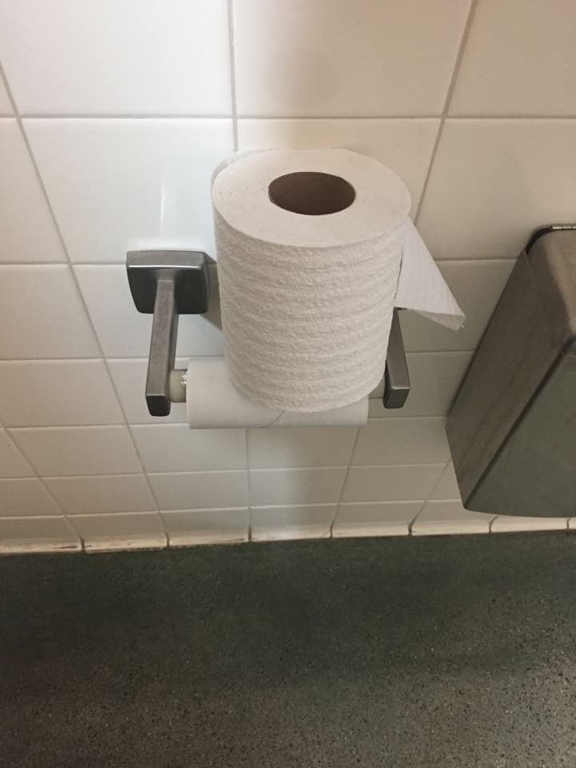
WHY PREPARE FOR THE POSITION:

Slide 31
WHAT TO EXPECT ON AN ASSESSMENT CENTER

Slide 32
WHAT TO EXPECT AT THE ASSESSMENT CENTER:
Candidates are assigned time/event slots
Standardized process for all
Position / job related activities

Slide 33
WHAT TO EXPECT AT THE ASSESSMENT CENTER:
Those evaluating you
May be created by inside or outside personnel
Most valid way to assess candidates

Slide 34
What do “they” want in a promotional candidate?

Slide 35
CONSIDER THIS:
  It’s not the resume that will get you promoted….
  It’s your current and past behavior and more importantly…..

Slide 36
CONSIDER THIS:
  Your ability to demonstrate to the raters & ultimately your department Command Staff, future supervisors, future peers & future subordinates that you can not only be a safe beginner, but you can hit the ground running, take care of your personnel, do what is right for the community, the department & the customers you serve!

Slide 37
Only 15% of your success is due to your technical knowledge – while 85% of your success is attributable to your ability to express ideas, arouse enthusiasm and lead people!
- Carnegie Institute of Technology

Slide 38

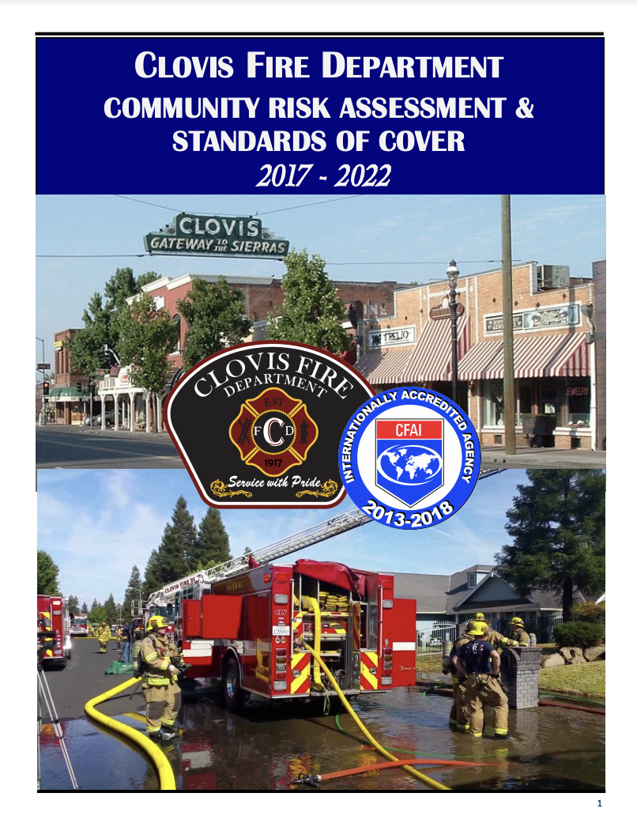
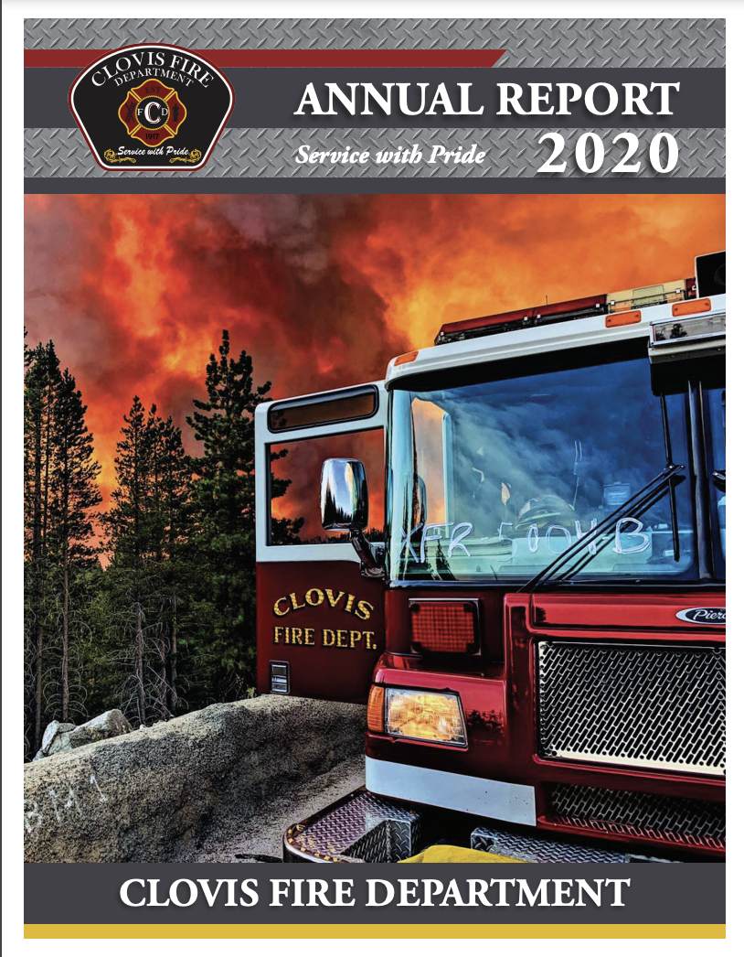
Mission, Vision, Values
SWOT analysis
Critical Issues & Service Gaps
Goals, Objectives, Critical Tasks
SOMEONE WHO GETS THE BIG PICTURE (Thinks Strategically)

Slide 39
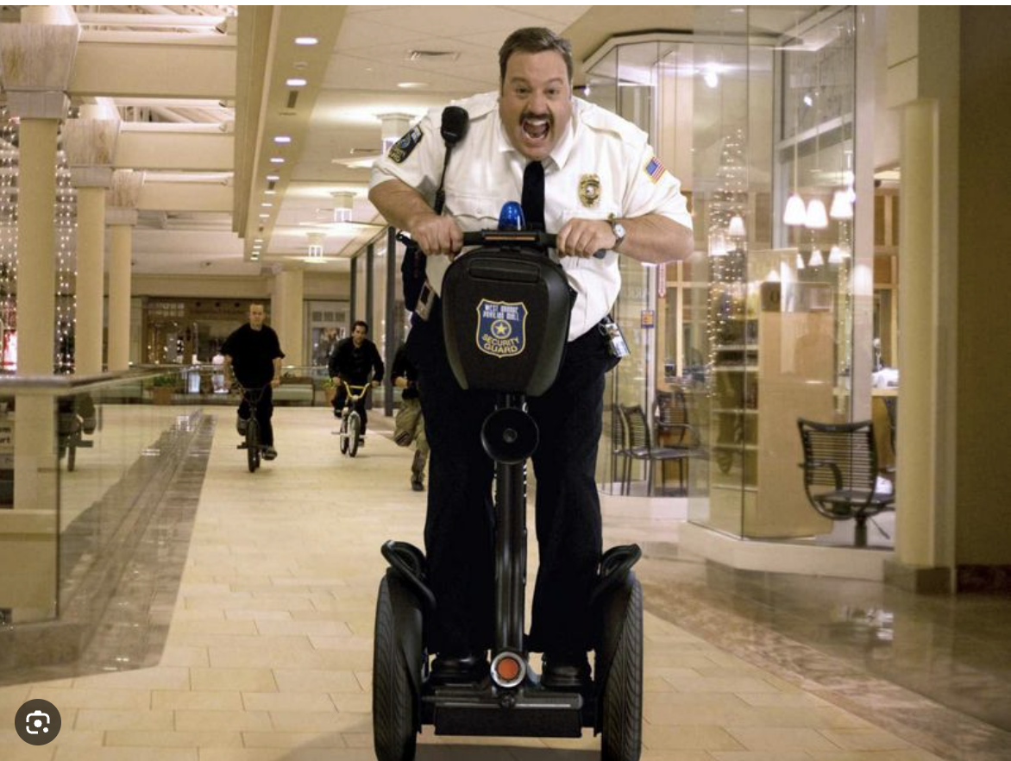
BE PAUL BLART:
Detect
Deter
Observe
Report

Slide 40
COMMON SCORING DIMENSIONS:
Oral communications
Written communications
Leadership
Command presence
Decision making
Delegation
Problem analysis
Problem solving ability

Slide 41
COMMON SCORING DIMENSIONS:
Organizational skills
Planning ability
ICS
Flexibility
Situational awareness
Time management
Strategy/tactics
Judgment

Slide 42
COMMON SCORING DIMENSIONS:
Knowledge of F.D. SOGs/SOPs, Rules and Regulations, etc.
Safety
Interpersonal skills
Ability to remain calm under pressure

Slide 43
COMMON SCORING DIMENSIONS:
Risk management
Customer service
Knowledge of local, state and federal standards and laws (OSHA, NFPA, accepted industry standards)

Slide 44
HOW WILL THEY RATE ME?
Standardized score sheets
Think of school – A, B, C, D & F or 100% to 90%, 89% to 80%, 79% to 70%, 69% to 60% etc.
If you don’t say it or do it, you don’t get credit for it!

Slide 45
HOW TO BEST PREPARE:
Talk to those who’ve taken or assisted with developing tests (inside & outside your FD)
Understand & practice the events you may see on the test
Review the job flyer
Review the job specifications
Prepare for the position!

Slide 46
SUCCESSFUL CANDIDATES:
Take the process seriously
Get involved
Network / get mentored / mentor others
Keep out of trouble
Train & educate themselves
Learn as much as they can

Slide 47
SUCCESSFUL CANDIDATES:
Prepare for ALL phases of the process
Know their strengths & weaknesses
Act is if they’re in the position
Are on time for all phases
Ensure their dress uniform still fits & is correctly labeled & displayed!

Slide 48
Resume Preparation

Slide 49
RESUME TIPS:
Remember the main difference between a resume and an application
Ideal length – 1 page
May be used as a screening mechanism (make sure you accurately showcase yourself)
Accentuate things with UPPERCASE, bold, italics, underline, bullets/dashes – using each sparingly and in various combinations

Slide 50
RESUME TIPS:
Use major headings such as Objective, Education, Experience, Community Service, etc.
Spell check, proofread, ensure accuracy
No references, hobbies, pictures, items that may show your age (high school, date of birth) or be used to discriminate against you

Slide 51
The Written Examination

Slide 52
THE WRITTEN EXAM:
- What to expect -
Usually 100 questions, multiple choice
May be a % of your final score, or used to determine whether you’ll go farther
Common subject areas include supervision, leadership, management, ICS, department manuals, strategy & tactics, etc.

Slide 53
THE WRITTEN EXAM:
- What to expect -
Know reading list well in advance
Obtain your own copies
Obtain any study guides
Study a little every day

Slide 54
THE WRITTEN EXAM:
- What to expect -
Start reading at least a year in advance
3 x 5 cards to study & be quizzed on
Write down questions afterward
Don’t read into the questions

Slide 55
The Oral Interview

Slide 56
ORAL INTERVIEWS:
- What to expect -
15 to 45 minutes of questions
Opening / closing statement www.code3firetraining.com - Free Stuff link
Questions on:
  The dept., the community, the position
  Your vision, values, leadership style, etc.
  How you would handle different situations
  Your background / current and future goals
  Customer service

Slide 57
ORAL INTERVIEWS:
- What to expect -
Know yourself inside and out.
Rehearse answers for all questions
“Don’t just answer the question, answer the question!”
  – www.code3firetraining.com - Free Stuff link
“Intro/Body/Conclusion” method
  – www.code3firetraining.com - Free Stuff link

Slide 58
ORAL INTERVIEWS:
- What to expect -
Back up statements with facts
Use personalized stories
Use experience to prove a point
Listen to the question
Answer how you would do it - not how you think they want you to
Show passion & enthusiasm!!!!

Slide 59
The Personnel Counseling Scenario

Slide 60
PERSONNEL COUNSELING:
- What to expect -
Role players or video based
May have follow-up questions
Is usually based on current issues relating to the department or fire service in general
Multiple problems
Expected to diffuse highly stressful situations
  For sample Personnel Counseling scenarios, go to – www.code3firetraining.com - Free Stuff link

Slide 61
PERSONNEL COUNSELING:
- Key Points -
Remember, it’s the behavior, not the person!
Understand progressive discipline & any rights personnel may have & how you fit in
Be able to be the designated adult
Ask open-ended questions

Slide 62
PERSONNEL COUNSELING:
- Key Points -
If role playing, don’t expect immediate agreement
Understand resources available to your department (EAP, CISD, etc.)
Create personnel expectations in advance
  – www.code3firetraining.com - Free Stuff link

Slide 63
PERSONNEL COUNSELING:
- FRISK Documentation Method -
F = FACTS evidencing employee’s unsatisfactory conduct.
R = RULE or authority violated by the employee’s behavior.
I = IMPACT of the employee’s unsatisfactory conduct on the workplace.

Slide 64
PERSONNEL COUNSELING:
- FRISK Documentation Method -
S = SUGGESTIONS to assist the employee in improving performance and directions as to the proper conduct the employee is expected to follow in the future. These directions are also referred to as directives such as “Effective immediately, you will….”

Slide 65
PERSONNEL COUNSELING:
- FRISK Documentation Method -
K = KNOWLEDGE of the employee’s right to respond to corrective documentation placed in personnel file.
Created in 1994 by Stephen J. Anderson

Slide 66
PERSONNEL COUNSELING:
- FRISK Documentation Method -
Primary Objectives:
  Effect positive change through clear communication
  Identify common elements necessary for legally sufficient documentation
  Simplify the drafting of documentation by establishing a framework

Slide 67
8 STEPS TO A SUCCESSFUL COUNSELING SESSION:
Start with a friendly greeting
Briefly state the problem
Let the employee explain their side, while you listen
Now you explain your side, what you have witnessed, and what facts you have while the employee listens

Slide 68
8 STEPS TO A SUCCESSFUL COUNSELING SESSION:
State the rules for desired behavior
Develop an action plan to get the desired behavior
Review with feedback from the employee
Have a positive closing

Slide 69
PERSONNEL COUNSELING:
- Key Points -
Items you need to address ASAP:
Issues relating to not treating others with respect and courtesy
Issues affecting customer service
Issues affecting service delivery
Issues relating to character traits

Slide 70
Class Activity
Personnel Videos

Slide 71
After A Long Night……….

Slide 72

CLICK HERE
After A Long Night

Slide 73
BASED ON PREVIOUS VIDEO:
How could this have been prevented?
Issues?
Policies violated?
What would you do and why?
Level of discipline and why?
Would you notify your supervisor?
What documentation to complete?

Slide 74
The Kitty………………

Slide 75

The Kitty………………

Slide 76
BASED ON PREVIOUS VIDEO:
How could this have been prevented?
Issues?
Policies violated?
What would you do and why?
Level of discipline and why?
Would you notify your supervisor?
What documentation to complete?

Slide 77
The Emergency Scene Simulation

Slide 78
EMERGENCY SIMULATION:
- What to expect -
5 to 45 minutes
One or more events
May be the first or later arriving unit
2 to 4 raters / one department proctor
May be static or dynamic
May have follow-up questions
Will be stressful

Slide 79
EMERGENCY SIMULATION:
- What to expect -
May have to document (worksheet, ICS form 201, NFIRS report)
May have A.S.A.P. challenges:
  Firefighter down, missing, trapped
  Civilians to rescue, evacuate, treat, diffuse
  Media in your face
  City folks in your face
  Exposure problems

Slide 80
EMERGENCY SIMULATION:
- Key Points -
Prepare for the position!
Expect any type of incident!
Practice every day!
Use ICS!
Call sufficient resources early!

Slide 81
EMERGENCY SIMULATION:
- Key Points -
Have a full alarm in staging if big event
Big fire = big water!
If you don’t say it, you didn’t do it!
Ask for “CAN” reports

Slide 82
EMERGENCY SIMULATION:
- Key Points -
Provide a detailed, concise & appropriate size-up and radio reports
When assigning units:
  Advise them what they’ll be called (ICS terminology) or who they’ll report to
  Give clear, concise orders that contain tactical objectives (1 to 3 total)

Slide 83
EMERGENCY SIMULATION:
- Key Points -
If provided paperwork, use it
Remember the incident doesn’t start when the bell goes off, & doesn‘t end when you leave the scene

Slide 84
EMERGENCY SIMULATION:
- Key Points -
Ensure “BENCHMARKS” are stated:
  Establish Command / Command Post location
  2 in / 2 out established or not established / RIC
  Strategic mode / Objectives
  Water supply
  Staging area location
  All clear / Secondary search completed
  Utilities secured
  PARs
  Under control

Slide 85
EMERGENCY SIMULATION:
- Key Points -
Ensure “NOTIFICATIONS” are stated:
  Utility company (gas & electric)
  Law enforcement (& supervisor)
  Ambulance (& supervisor)
  Key FD personnel (Safety, PIO, Fire Investigator, Senior Staff, Duty Chief, etc.)
  Station move-ups / Volunteer call-back
  Mass Casualty Incident alert
  Board-up Company / American Red Cross
  City officials (Building Official, City Manager)

Slide 86
INDIVIDUAL ACTIVITY:
Report On Conditions Practice
You are the first arriving Officer (Company or Chief) – write out your on scene, 30 seconds or less, radio report

Slide 87
Initial RADIO REPORT:
Unit ID
Brief description of incident situation
Obvious conditions
Brief description of action taken
Command mode & command post location

Slide 88
Initial RADIO REPORT:
Strategic mode
Obvious safety concerns
Need for additional resources & staging area (or release of units)
Corrected address (if applicable)
    All of the above in 30 seconds or less…

Slide 89
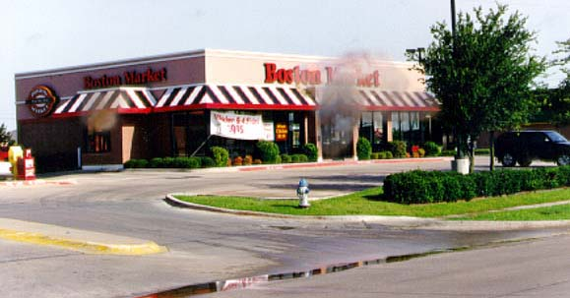
Water Supply
Area
Life Safety
Location /
Extent
Apparatus
Construction /
Collapse
potential
Exposures
Weather
Auxiliary
Appliances
Special Matters
848 El Monte Road

Slide 90
INDIVIDUAL ACTIVITY:
Size-Up Practice
You are the first arriving Officer (Company or Chief) – write out all of your Size-Up concerns related to the same situation

Slide 91
SIZE-UP:
W (Water Supply)
A (Area)
L (Life Safety)
L (Location / Extent)
A (Apparatus Responding)
C (Construction / Collapse Potential)
E (Exposures)

Slide 92
SIZE-UP:
W (Weather)
A (Auxiliary Appliances)
S (Special Matters)
H (Height)
O (Occupancy)
T (Time of Day)

Slide 93
Water Supply
Area
Life Safety
Location /
Extent
Apparatus
Construction /
Collapse
potential
Exposures
Weather
Auxiliary
Appliances
Special Matters
848 El Monte Road

Slide 94
INDIVIDUAL ACTIVITY:
Assign Your First Alarm Companies
You are the first arriving Officer (Company or Chief) – write out your assignments for your first-alarm companies (ICS designator & tactical objectives)

Slide 95
Water Supply
Area
Life Safety
Location /
Extent
Apparatus
Construction /
Collapse
potential
Exposures
Weather
Auxiliary
Appliances
Special Matters
848 El Monte Road

Slide 96
INDIVIDUAL ACTIVITY:
You will have five minutes to:
  Write out or verbalize your on-scene radio report (30 seconds or less) as the 1st due officer
  Write out your size-up concerns (FPODP, WALLACE WAS HOT, etc.)
  Assign your normal first-alarm companies

Slide 97

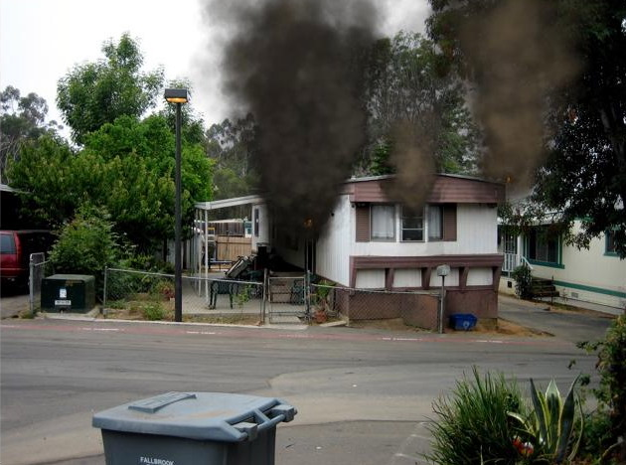

#3 – Size-up & Radio Reports
The following radio report assumes:
  Your first alarm is 3 engines, 1 truck, 1 rescue and 1 chief officer
    Engines 1, 2 & 3, Truck 1, Battalion 1, Rescue 1
  Responding units are staffed with 3 or 4
  Obviously assignments may changed based on your staffing & resource levels, not to mention your SOP/SOGs

Slide 98
INDIVIDUAL ACTIVITY:
You will have five minutes to:
  Write out or verbalize your on-scene radio report (30 seconds or less) as the 1st due officer
  Write out your size-up concerns (FPODP, WALLACE WAS HOT, etc.)
  Assign your normal first-alarm companies

Slide 99
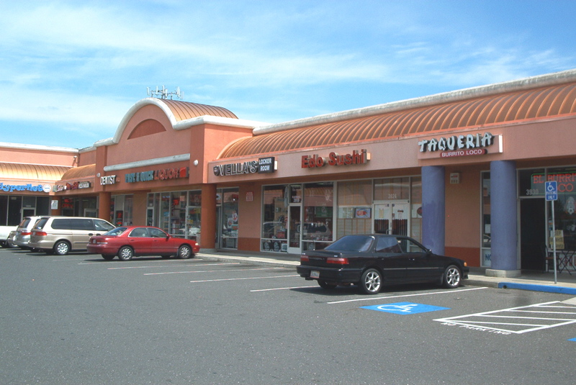
Water Supply
Area
Life Safety
Location /
Extent
Apparatus
Construction /
Collapse
potential
Exposures
Weather
Auxiliary
Appliances
400 Rincon Avenue, #31

Slide 100
INDIVIDUAL ACTIVITY:
You will have five minutes to:
  Write out or verbalize your on-scene radio report (30 seconds or less) as the 1st due officer
  Write out your size-up concerns (FPODP, WALLACE WAS HOT, etc.)
  Assign your normal first-alarm companies

Slide 101
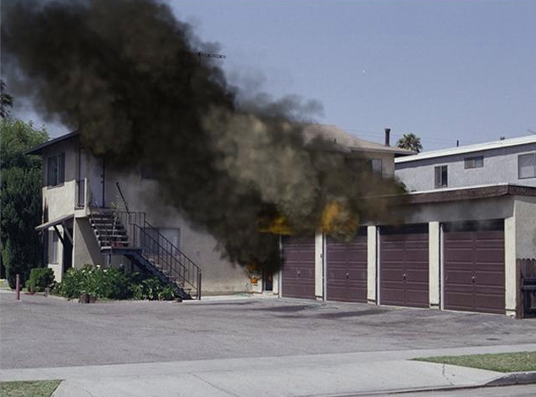
565 Smith Street

Slide 102
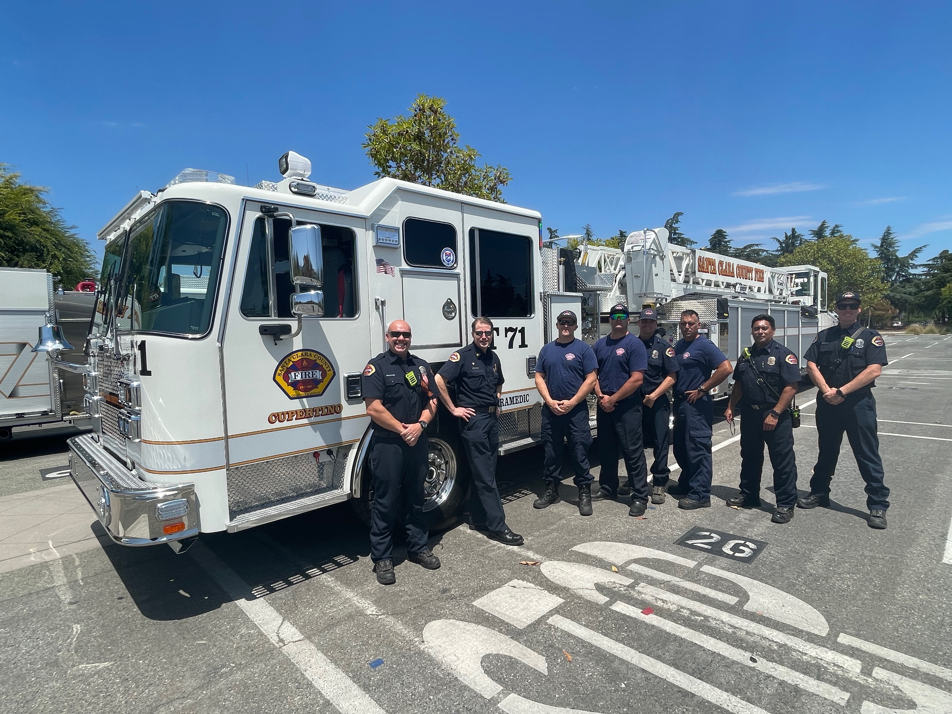
THERE IS NOBODY ELSE COMING:
Be the Crew You Want to Help Your Loved Ones & It’s Not About Us – It’s About Them!
CLICK HERE
Video – Command Presence at it’s best!

Slide 103
Remember – Every Day Is An Assessment Center!!!!!!!

Slide 104
Thank you very much for your time – be well & stay well!
Steve Prziborowski
(408) 205-9006 – Cellular
www.code3firetraining.com
SPrziborowski – X / Twitter
LinkedIn: Steve Prziborowski
YouTube: Steve Prziborowski
Instagram: steveprziborowski
steve.prziborowski@gmail.com

